Slide 1


PowerPoint Event Management Proposal Template Example
ELEVATE EVENT MANAGEMENT | Submission Date: MM/DD/YY
EVENT PRO INNOVATORS

Slide 2

CONTENTS
1
COMPANY INTRODUCTION
6
BUDGET ESTIMATION
2
PREVIOUS SUCCESSES
7
MARKETING AND PROMOTION PLAN
8
TIMELINE AND MILESTONES
3
PROPOSAL OVERVIEW
4
EVENT STRATEGY AND EXECUTION
9
TESTIMONIALS
AND CLIENT FEEDBACK
5
VENUE OPTIONS
10
CALL TO ACTION

Slide 3
1. COMPANY INTRODUCTION
Introduction to Event Pro Innovators, with a focus on our decade-long experience and commitment to creating unforgettable events.
SERVICES OFFERED
Key logistics
Creative design
Tech integration
EVENT PRO INNOVATORS

Slide 4



2. PREVIOUS SUCCESSES
Highlights from Tech Con 20XX with a 95% attendee satisfaction rate and Green Summit 20XX, which had a 30% year-on-year growth in participation.
Replace with images and photos related to your past event experience.
95%
30%
ATTENDEE SATISFACTION
GROWTH

Slide 5


3. PROPOSAL OVERVIEW
Event Objectives
Event Goals
Connecting industry leaders.
Fusing technology, networking, and development goals.
Overview of the proposed event, aiming to connect industry leaders and foster innovation in the tech sector.

Slide 6
4. EVENT STRATEGY AND EXECUTION
Event Objectives
STAGE 1
Pre-event marketing
STAGE 2
Event stakeholder meeting
Strategy includes thematic development, participant engagement, and seamless logistical execution for Elevate 20XX.
STAGE 3
Venue promotions begin
STAGE 4
Release ticket sales
STAGE 5
Event
STAGE 6
Post-event follow-up
Build a flow chart that aligns with the hierarchy of your event structure, illustrating the event’s flow.

Slide 7
5. VENUE OPTIONS
Information about potential event venues, including pros and cons for each
VENUE NAME | PROs | CONs
Venue A | Description Description | Description Description
Venue B | Description Description | Description Description
Venue C | Description Description | Description Description
Venue D | Description Description | Description Description
Venue E | Description Description | Description Description

Slide 8
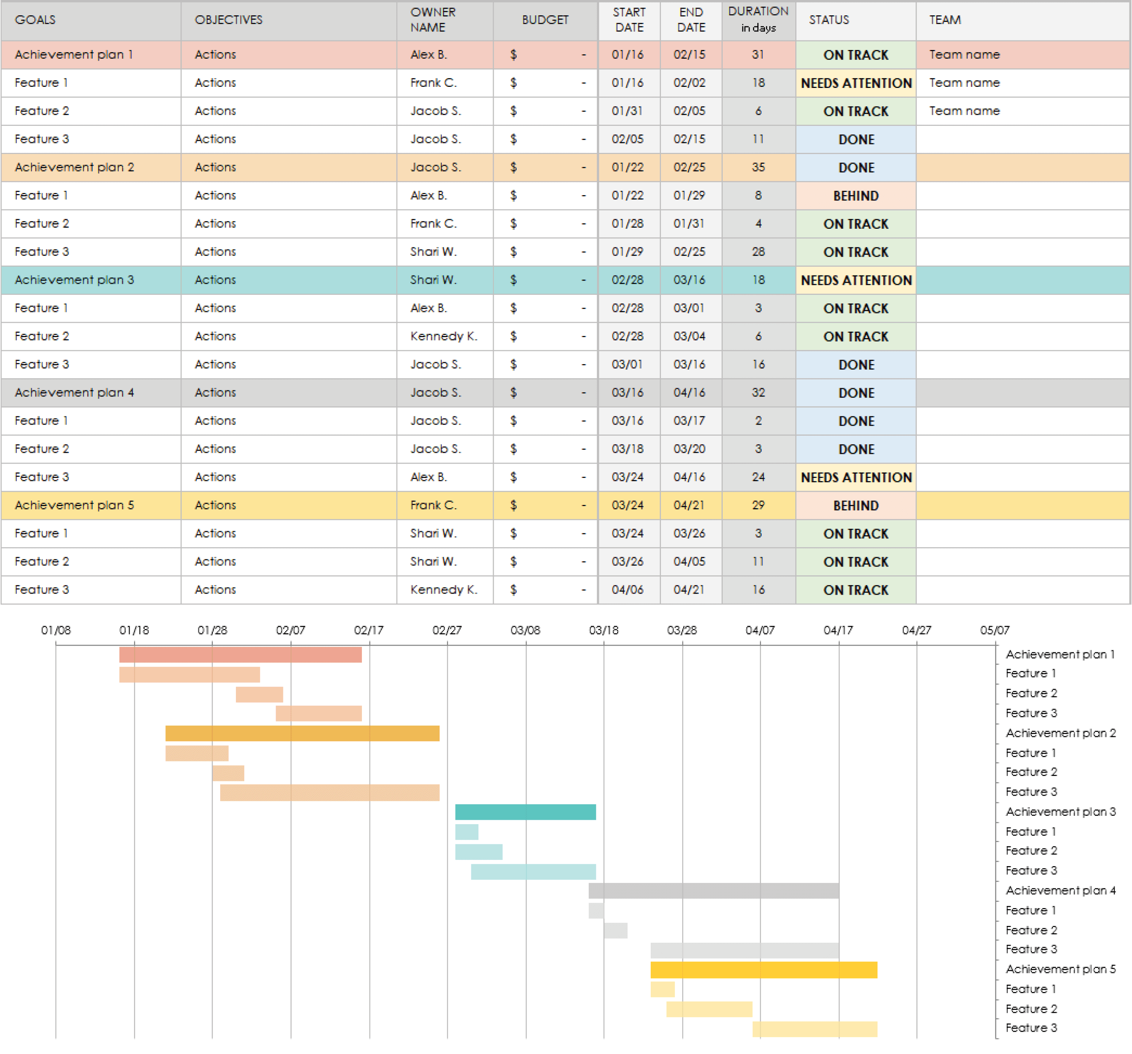
6. BUDGET ESTIMATION
Estimated budget outlining venue costs, speaker fees, and interactive tech setups, with customizable options for various event scales.
Build your itemized event budget spreadsheet in Excel, with tables, charts, etc. Then, embed the file here and/or include a static image of the Excel spreadsheet. Include flexible options based on the scale of the event.

Slide 9

7. MARKETING AND PROMOTION PLAN
Multi-channel marketing strategy using social media, industry partnerships, and influencer engagements.
Replace with images or videos of promotional materials directly related to your marketing plan.

Slide 10
8. TIMELINE AND MILESTONES
TODAY
TASKS | DAY 1 | DAY 2 | DAY 3 | DAY 4 | DAY 5 | DAY 6
Task 1
Task 2
Task 3
Task 4
Task 5
Task 6
Task 7
Task 8
Task 9
Task 10
Due 00/00
Due 00/00
Milestone 1
Needs Review
Milestone 1 – 00/00
Due 00/00
Due 00/00
Due 00/00
Due 00/00
Due 00/00
Task Owner 1
Task Owner 3
Task Owner 5
Task Owner 7
Task Owner 2
Task Owner 4
Task Owner 6
Task Owner 8

Slide 11




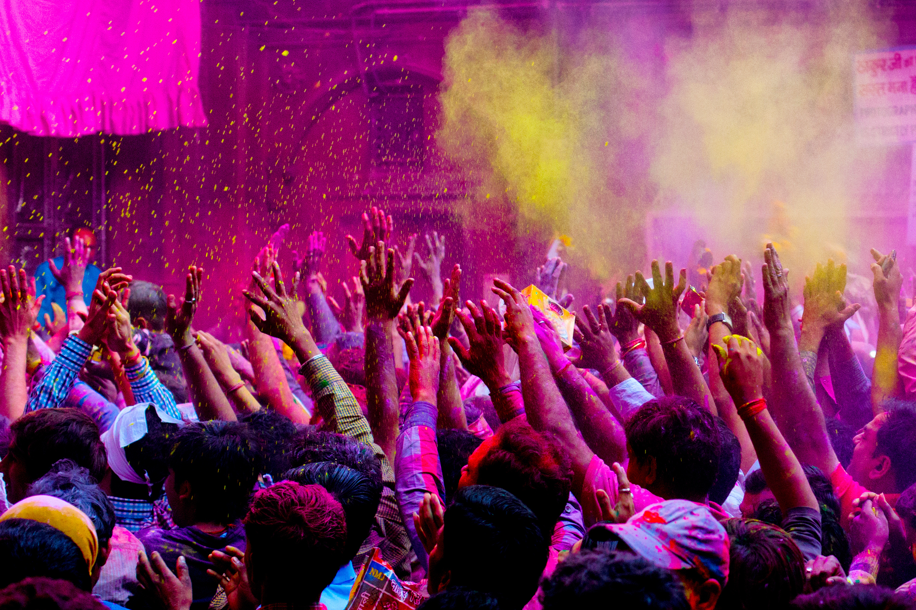
9. TESTIMONIALS AND CLIENT FEEDBACK
This management team delivers!
- Romy B. Tech Con 20XX
Replace with testimonials and/or images from past events and include multiple quotes.

Slide 12
10. CALL TO ACTION
How to proceed with sponsoring or participating in this event…
Website
Social Media Information
Person of Contact: Name, Title
Phone
Email
Address
Insert QR code
Your logo here

Slide 13
DISCLAIMER Any articles, templates, or information provided by Smartsheet on the website are for reference only. While we strive to keep the information up to date and correct, we make no representations or warranties of any kind, express or implied, about the completeness, accuracy, reliability, suitability, or availability with respect to the website or the information, articles, templates, or related graphics contained on the website. Any reliance you place on such information is therefore strictly at your own risk.

