Slide 1

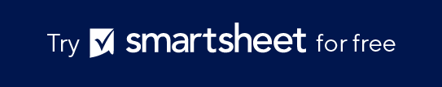
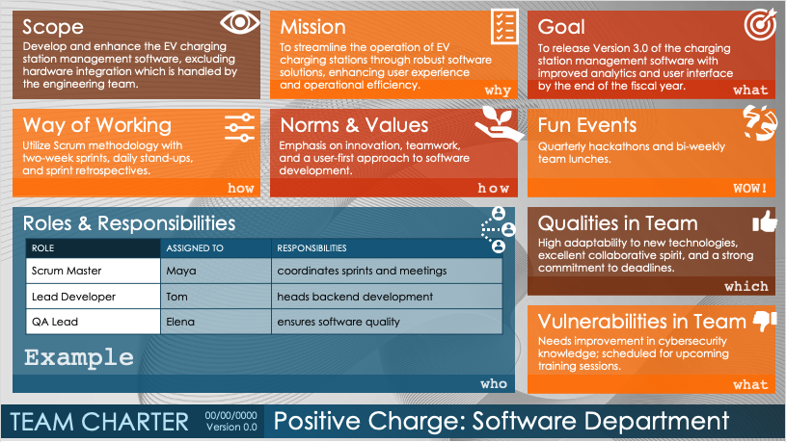
Basic Team Charter Slide Template
When to Use This Template: Use this template to create presentations that define team scope, roles, working methods, and objectives. This template is ideal for team meetings and project kick-offs.
Notable Template Highlights: Any team can use this template to maintain focus and stick to clear goals. It includes sections for scope, roles and responsibilities, way of working, and mission. It also includes sections for Fun Events, Norms, and Values, which you can define to foster team spirit and a collaborative environment.

Slide 2








Scope
Mission
Goal
Define what the team will and will not focus on.
“Focusing on product development, excluding market analysis.”
Explain the team's core purpose.
"To create a user-centric software solution that enhances client productivity."
Specify the primary objective the team aims to achieve. "Launch the new application by Q3, achieving a customer satisfaction score of at least 80%."
in-scope / out-of-scope
why
what
Way of Working
Norms & Values
Fun Events
Describe the team’s operational methods and practices.
"Agile sprints with bi-weekly reviews."
State the team’s principles and expected behavior. "Respect, transparency, and proactive communication in all interactions."
Plan activities that build team spirit and camaraderie. "Monthly team outings and weekly virtual game nights."
how
how
WOW!
Roles & Responsibilities
Clarify each team member's duties and roles.
"John leads design, Lisa oversees testing."
Qualities in Team
ROLE | ASSIGNED TO | RESPONSIBILITIES
Highlight the positive attributes and strengths of the team. "Creativity, technical expertise, and strong problem-solving skills."
which
Vulnerabilities in Team
Identify potential weaknesses or areas for improvement within the team. "Limited experience with cloud integration, requiring external training."
who
what
TEAM CHARTER
00/00/0000
TEAM NAME
Version 0.0

Slide 3
Scope
Mission
Goal
Develop and enhance the EV charging station management software, excluding hardware integration which is handled by the engineering team.
To streamline the operation of EV charging stations through robust software solutions, enhancing user experience and operational efficiency.
To release Version 3.0 of the charging station management software with improved analytics and user interface by the end of the fiscal year.
why
what
Way of Working
Norms & Values
Fun Events
Utilize Scrum methodology with two-week sprints, daily stand-ups, and sprint retrospectives.
Emphasis on innovation, teamwork, and a user-first approach to software development.
Quarterly hackathons and bi-weekly team lunches.
how
how
WOW!
Roles & Responsibilities
Qualities in Team
ROLE | ASSIGNED TO | RESPONSIBILITIES
Scrum Master | Maya | coordinates sprints and meetings
Lead Developer | Tom | heads backend development
QA Lead | Elena | ensures software quality
High adaptability to new technologies, excellent collaborative spirit, and a strong commitment to deadlines.
which
Vulnerabilities in Team
Example
Needs improvement in cybersecurity knowledge; scheduled for upcoming training sessions.
who
what
TEAM CHARTER
00/00/0000
Positive Charge: Software Department
Version 0.0

Slide 4
DISCLAIMER Any articles, templates, or information provided by Smartsheet on the website are for reference only. While we strive to keep the information up to date and correct, we make no representations or warranties of any kind, express or implied, about the completeness, accuracy, reliability, suitability, or availability with respect to the website or the information, articles, templates, or related graphics contained on the website. Any reliance you place on such information is therefore strictly at your own risk.

