Slide 1

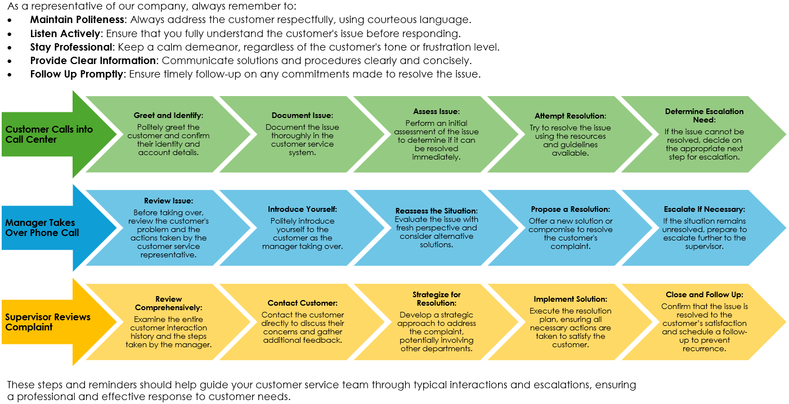
Customer Service Escalation Matrix Template
When To Use This Template:
Use this template to manage and escalate customer service issues effectively, ensuring that customer interactions are handled politely and escalated appropriately for resolution.
Notable Templates Features:
Features for this template include a bulleted list of polite interaction reminders for customer service representatives, and workflows for handling customer calls, manager escalations, and supervisor complaint reviews, ensuring a structured and courteous approach to resolving customer issues.

Slide 2
Customer Service Escalation Matrix
As a representative of our company, always remember to:
Maintain Politeness: Always address the customer respectfully, using courteous language.
Listen Actively: Ensure that you fully understand the customer's issue before responding.
Stay Professional: Keep a calm demeanor, regardless of the customer's tone or frustration level.
Provide Clear Information: Communicate solutions and procedures clearly and concisely.
Follow Up Promptly: Ensure timely follow-up on any commitments made to resolve the issue.
Greet and Identify:
Politely greet the customer and confirm their identity and account details.
Document Issue:
Document the issue thoroughly in the customer service system.
Assess Issue:
Perform an initial assessment of the issue to determine if it can be resolved immediately.
Customer Calls into Call Center
Attempt Resolution:
Try to resolve the issue using the resources and guidelines available.
Determine Escalation Need:
If the issue cannot be resolved, decide on the appropriate next step for escalation.
Review Issue:
Before taking over, review the customer's problem and the actions taken by the customer service representative.
Introduce Yourself:
Politely introduce yourself to the customer as the manager taking over.
Reassess the Situation:
Evaluate the issue with fresh perspective and consider alternative solutions.
Manager Takes Over Phone Call
Propose a Resolution:
Offer a new solution or compromise to resolve the customer's complaint.
Escalate If Necessary:
If the situation remains unresolved, prepare to escalate further to the supervisor.
Review Comprehensively:
Examine the entire customer interaction history and the steps taken by the manager.
Contact Customer:
Contact the customer directly to discuss their concerns and gather additional feedback.
Strategize for Resolution:
Develop a strategic approach to address the complaint, potentially involving other departments.
Supervisor Reviews Complaint
Implement Solution:
Execute the resolution plan, ensuring all necessary actions are taken to satisfy the customer.
Close and Follow Up:
Confirm that the issue is resolved to the customer’s satisfaction and schedule a follow-up to prevent recurrence.
These steps and reminders should help guide your customer service team through typical interactions and escalations, ensuring a professional and effective response to customer needs.

Slide 3
DISCLAIMER Any articles, templates, or information provided by Smartsheet on the website are for reference only. While we strive to keep the information up to date and correct, we make no representations or warranties of any kind, express or implied, about the completeness, accuracy, reliability, suitability, or availability with respect to the website or the information, articles, templates, or related graphics contained on the website. Any reliance you place on such information is therefore strictly at your own risk.

