Slide 1


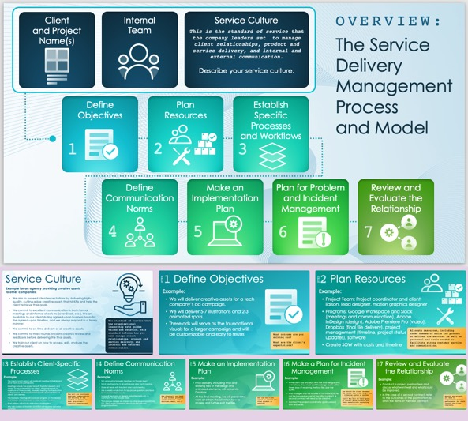
Service Delivery Management Plan Template with Sample Data
Use this free template to guide your SDM process. It includes fields for each essential step of your plan. It also includes space to document the service culture, ensuring that your plan embodies your organization’s values. Available with or without sample data, the template will facilitate your SDM planning process.

Slide 2






Client
and Project Name(s)
Internal
Team
Service Culture
This is the standard of service that the company leaders set to manage client relationships, product and service delivery, and internal and external communication.
Describe your service culture.
OVERVIEW:
The Service Delivery Management Process
and Model
Define Objectives
Plan
Resources
Establish Specific Processes
and Workflows
1
2
3
Define Communication Norms
Make an Implementation Plan
Plan for Problem and Incident Management
Review and Evaluate the Relationship
4
5
6
7

Slide 3
Service Culture
Example for an agency providing creative assets to other companies:
We aim to exceed client expectations by delivering high-quality, cutting-edge creative assets that hit KPIs and help the client achieve their goals.
We commit to excellent communication in both formal meetings and informal check-ins (over Slack, etc.). We are available to our client during agreed-upon business hours for the agreed-upon timeline, and we always respond in a timely manner.
We commit to on-time delivery of all creative assets.
We commit to three rounds of client creative review and feedback before delivering the final assets.
We train our client on how to access, edit, and use the creative assets.
The standard of service that the organizational leadership sets guides values and behavior. This standard informs how you will manage client relationships, product and service delivery, and internal and external communication.

Slide 4
1
Define Objectives
STEP
Example:
We will deliver creative assets for a tech company’s ad campaign.
We will deliver 5-7 illustrations and 2-3 animated spots.
These ads will serve as the foundational visuals for a larger campaign and will be customizable and easy to reuse.
What outcome are you solving for?
What are the client’s expectations?

Slide 5
2
Plan Resources
STEP
Example:
Project Team: Project coordinator and client liaison, lead designer, motion graphics designer
Programs: Google Workspace and Slack (meetings and communication), Adobe InDesign (design), Adobe Premiere Pro (video), Dropbox (final file delivery), project management (timeline, project status updates), software
Create SOW with costs and timeline
Allocate resources, including those needed to build the product or deliver the service, as well as personnel and tools needed to facilitate strong customer service and communication.

Slide 6
3
Establish Client-Specific Processes
STEP
Example:
The internal point person will create all meeting invite links and send them out to participants.
Meetings include the project kickoff, the initial research and design (to be reviewed by the client), design approval (a maximum of three rounds), biweekly meetings for the duration of the project, the final presentation (with approval from the client), and delivery.
The biweekly meetings will showcase progress on the designs and include client feedback in case we need to pivot.
Final delivery will include all final and working files.
Any asks outside of the initial SOW/SLA will require a separate contract.
How will you coordinate meetings, communication, and delivery of the product or service to meet this client’s specific expectations?

Slide 7
4
Define Communication Norms
STEP
Example:
Set up recurring biweekly meetings via Google Meet.
Send meeting notes to all participants after each meeting.
Share all decks with the client after each meeting.
Use a weekly email chain for big-picture questions and Slack for more immediate needs.
Leave all feedback on designs, advertisements, etc. in comments on the Google Slides.
*If in-process designs are shared via other programs/platforms (i.e., Miro), leave comments directly on the relevant program/platform.
How often will you check in and on what platforms (video meetings, chat services, email, etc.)?

Slide 8
5
Make an Implementation Plan
STEP
Example:
Final delivery, including final and working files of the design and animated elements, will occur via Dropbox.
At the final meeting, we will present the work and train the client on how to access and further edit the files.
How can the client expect to receive the final product or service?

Slide 9
6
Make a Plan for Incident Management
STEP
Example:
If the client has any issue with the final designs and animations, they must alert the design team within three days of receiving the final files (per the SOW).
Any changes that fall outside of the initial SOW will not be honored as part of the initial contract. A second contract will need to be created.
Contact the project coordinator (point person) with any issues.
How should the client document any issues that arise (e.g., via a ticketing system or another incident report management tool)? Who will be their point of contact going forward? Are there expectations concerning issue resolution time?

Slide 10
7
Review and Evaluate the Relationship
STEP
Example:
Conduct a project postmortem and discuss what went well and what could be improved.
In the case of a second contract, refer to the outcomes of the postmortem to drive the terms of the new contract.
As with any project, you need to continuously monitor performance. So, check in with the client regularly.

Slide 11
DISCLAIMER Any articles, templates, or information provided by Smartsheet on the website are for reference only. While we strive to keep the information up to date and correct, we make no representations or warranties of any kind, express or implied, about the completeness, accuracy, reliability, suitability, or availability with respect to the website or the information, articles, templates, or related graphics contained on the website. Any reliance you place on such information is therefore strictly at your own risk.

