Slide 1



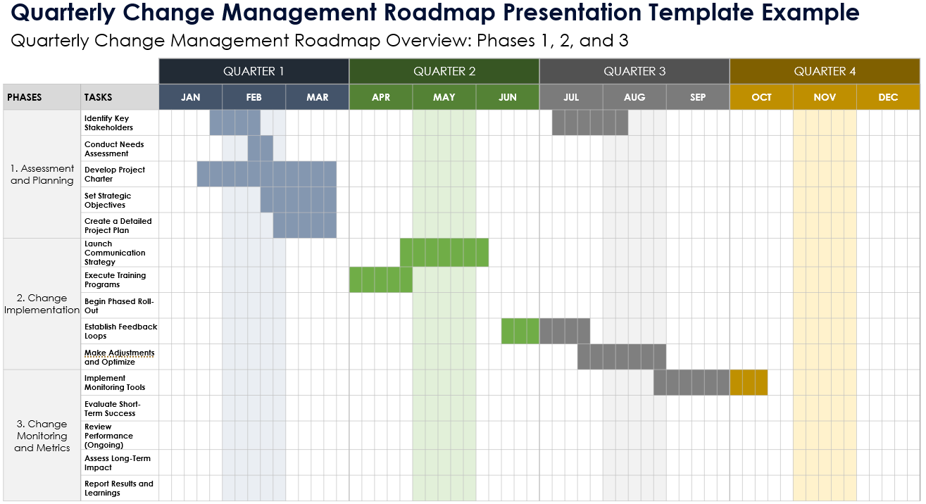
Quarterly Change Management Roadmap Presentation Template Example

Slide 2
Quarterly Change Management Roadmap Overview: Phases 1, 2, and 3
 |  | QUARTER 1 |  |  |  |  |  |  |  |  |  |  |  |  |  |  | QUARTER 2 |  |  |  |  |  |  |  |  |  |  |  |  |  |  | QUARTER 3 |  |  |  |  |  |  |  |  |  |  |  |  |  |  | QUARTER 4
PHASES | TASKS | JAN |  |  |  |  | FEB |  |  |  |  | MAR |  |  |  |  | APR |  |  |  |  | MAY |  |  |  |  | JUN |  |  |  |  | JUL |  |  |  |  | AUG |  |  |  |  | SEP |  |  |  |  | OCT |  |  |  |  | NOV |  |  |  |  | DEC
1. Assessment and Planning | Identify Key Stakeholders
 | Conduct Needs Assessment
 | Develop Project Charter
 | Set Strategic Objectives
 | Create a Detailed Project Plan
2. Change Implementation | Launch Communication Strategy
 | Execute Training Programs
 | Begin Phased Roll-Out
 | Establish Feedback Loops
 | Make Adjustments and Optimize
3. Change Monitoring and Metrics | Implement Monitoring Tools
 | Evaluate Short-Term Success
 | Review Performance (Ongoing)
 | Assess Long-Term Impact
 | Report Results and Learnings

Slide 3
Roadmap Overview: Phase 1
 |  | QUARTER 1 |  |  |  |  |  |  |  |  |  |  |  |  |  |  | QUARTER 2 |  |  |  |  |  |  |  |  |  |  |  |  |  |  | QUARTER 3 |  |  |  |  |  |  |  |  |  |  |  |  |  |  | QUARTER 4
PHASE 1 | TASKS | JAN |  |  |  |  | FEB |  |  |  |  | MAR |  |  |  |  | APR |  |  |  |  | MAY |  |  |  |  | JUN |  |  |  |  | JUL |  |  |  |  | AUG |  |  |  |  | SEP |  |  |  |  | OCT |  |  |  |  | NOV |  |  |  |  | DEC
1. Assessment and Planning | Identify Key Stakeholders: Determine all relevant stakeholders and their roles in the change process. Address their needs and concerns.
 | Conduct Needs Assessment: Analyze the organization's current state to pinpoint deficiencies and areas for improvement that the change should address.
 | Develop Project Charter: Create a formal document that outlines the scope, objectives, and participants involved in the change project. Use this charter as a foundational tool for alignment and accountability.
 | Set Strategic Objectives: Define clear, measurable goals that align with the organization's strategic vision and communicate these objectives.
 | Create a Detailed Project Plan: Develop a comprehensive plan including timelines, resources, budget, and specific actions to implement the change. This plan should also outline change communication throughout the organization.

Slide 4
Roadmap Overview: Phase 2
 |  | QUARTER 1 |  |  |  |  |  |  |  |  |  |  |  |  |  |  | QUARTER 2 |  |  |  |  |  |  |  |  |  |  |  |  |  |  | QUARTER 3 |  |  |  |  |  |  |  |  |  |  |  |  |  |  | QUARTER 4
PHASE 2 | TASKS | JAN |  |  |  |  | FEB |  |  |  |  | MAR |  |  |  |  | APR |  |  |  |  | MAY |  |  |  |  | JUN |  |  |  |  | JUL |  |  |  |  | AUG |  |  |  |  | SEP |  |  |  |  | OCT |  |  |  |  | NOV |  |  |  |  | DEC
2. Change Implementation | Launch Communication Strategy: Begin the change process by rolling out a strategic communication plan that informs, engages, and prepares all stakeholders for the changes to come.
 | Execute Training Programs: Implement training sessions to prepare employees for new systems, processes, or roles instituted as part of the change.
 | Begin Phased Roll-Out: Start implementing the change in phases. Allow for adjustments and modifications based on initial feedback and the complexity of the change.
 | Establish Feedback Loops: Create mechanisms for continuous feedback from employees and other stakeholders to gauge the reception of the change and identify any areas needing additional support or adjustment.
 | Make Adjustments and Optimize: Make necessary adjustments to the change initiatives based on feedback and initial outcomes to ensure the change effectively meets its objectives.

Slide 5
Roadmap Overview: Phase 3
 |  | QUARTER 1 |  |  |  |  |  |  |  |  |  |  |  |  |  |  | QUARTER 2 |  |  |  |  |  |  |  |  |  |  |  |  |  |  | QUARTER 3 |  |  |  |  |  |  |  |  |  |  |  |  |  |  | QUARTER 4
PHASE 3 | TASKS | JAN |  |  |  |  | FEB |  |  |  |  | MAR |  |  |  |  | APR |  |  |  |  | MAY |  |  |  |  | JUN |  |  |  |  | JUL |  |  |  |  | AUG |  |  |  |  | SEP |  |  |  |  | OCT |  |  |  |  | NOV |  |  |  |  | DEC
3. Change Monitoring and Metrics | Implement Monitoring Tools: Set up systems or tools that continuously monitor the performance and impact of the changes against predefined KPIs.
 | Evaluate Short-Term Success: Assess early results of the change implementation to determine if the change is on track to meet the desired goals.
 | Review Performance (Ongoing): Regularly review performance data to ensure the change has the intended effect and identify areas for continuous improvement.
 | Assess Long-Term Impact: Evaluate the long-term success and sustainability of the change, including its impact on organizational culture, efficiency, and overall performance.
 | Report Results and Learnings: Document and share the outcomes and key learnings from the change initiative with stakeholders and use this information to inform future change efforts.

Slide 6
NOTES
Summary Information / Comments

Slide 7
DISCLAIMER Any articles, templates, or information provided by Smartsheet on the website are for reference only. While we strive to keep the information up to date and correct, we make no representations or warranties of any kind, express or implied, about the completeness, accuracy, reliability, suitability, or availability with respect to the website or the information, articles, templates, or related graphics contained on the website. Any reliance you place on such information is therefore strictly at your own risk.

