Slide 1

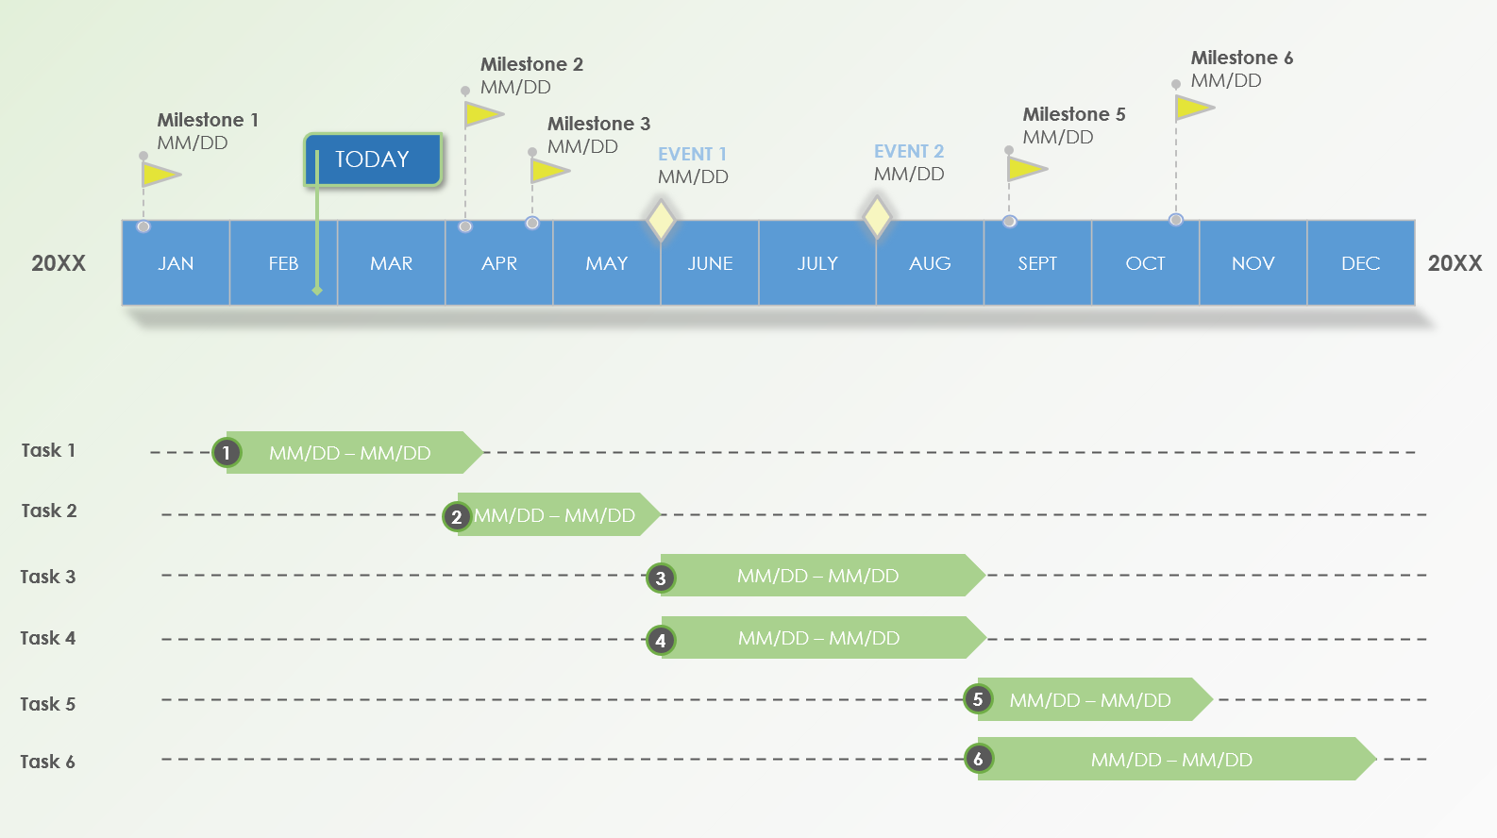
PowerPoint Yearly Timeline Template
When to use this Template: Use this template for outlining long-term project timelines or annual company events. It provides a comprehensive visual overview of the entire year, ideal for streamlined yearly planning or strategic reviews.
Notable Template Features: This template provides a yearly Gantt chart for easy addition and adjustment of events and milestones, facilitating long-range planning and tracking.

Slide 2
Milestone 2
MM/DD
Milestone 6
MM/DD
Milestone 1
MM/DD
Milestone 3
MM/DD
Milestone 5
MM/DD
TODAY
EVENT 1
MM/DD
EVENT 2
MM/DD
JAN | FEB | MAR | APR | MAY | JUNE | JULY | AUG | SEPT | OCT | NOV | DEC
20XX
20XX
Task 1
1
MM/DD – MM/DD
Task 2
2
MM/DD – MM/DD
Task 3
MM/DD – MM/DD
3
Task 4
4
MM/DD – MM/DD
MM/DD – MM/DD
Task 5
5
Task 6
MM/DD – MM/DD
6

Slide 3
DISCLAIMER Any articles, templates, or information provided by Smartsheet on the website are for reference only. While we strive to keep the information up to date and correct, we make no representations or warranties of any kind, express or implied, about the completeness, accuracy, reliability, suitability, or availability with respect to the website or the information, articles, templates, or related graphics contained on the website. Any reliance you place on such information is therefore strictly at your own risk.

