Slide 1
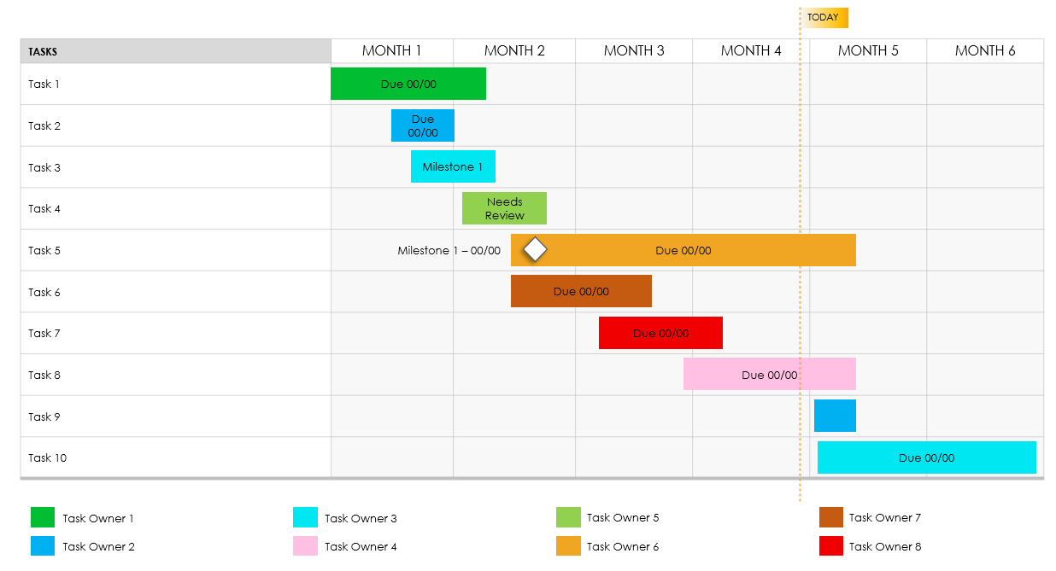
PowerPoint Project Timeline Template
When to Use This Template: Choose this template when managing complex projects that need detailed month-by-month tracking. This template is a great choice for project managers who need to track and present project statuses to stakeholders.
Notable Template Features: This fully customizable Gantt chart template enables you to set your own timeline. Follow the sample text for help mapping out your project’s timeline.

Slide 2
TODAY
TASKS | MONTH 1 | MONTH 2 | MONTH 3 | MONTH 4 | MONTH 5 | MONTH 6
Task 1
Task 2
Task 3
Task 4
Task 5
Task 6
Task 7
Task 8
Task 9
Task 10
Due 00/00
Due 00/00
Due 00/00
Needs Review
Milestone 1 – 00/00
Due 00/00
Due 00/00
Due 00/00
Due 00/00
Due 00/00
Task Owner 1
Task Owner 3
Task Owner 5
Task Owner 7
Task Owner 2
Task Owner 4
Task Owner 6
Task Owner 8

Slide 3
EXAMPLE: The tasks, milestones, and roles will help structure our timeline, providing a path for the rollout of new EV-charging stations over the next six months.
TODAY
TASKS | MONTH 1 | MONTH 2 | MONTH 3 | MONTH 4 | MONTH 5 | MONTH 6
Site Survey and Analysis: Conduct surveys to identify optimal locations for new charging stations.
Permit Acquisition: Secure necessary permits from local governments and regulatory bodies.
Infrastructure Development: Begin construction of charging station infrastructure.
Technology Integration: Implement smart charging technology systems.
Testing and Quality Assurance: Conduct comprehensive tests to ensure system reliability.
Marketing Launch: Initiate marketing campaigns to promote new stations.
Staff Training: Train staff on operations and customer service.
Public Launch Event: Organize an event to officially launch the new stations.
Customer Feedback Collection: Gather initial user feedback for improvements.
Expansion Planning: Plan for the next phase of expansion based on feedback and initial usage data.
All Potential Sites Documented MM/DD
Permits Approved MM/DD
First Station Operational MM/DD
100TH Customer Served MM/DD
Feedback Review MM/DD
Alex R. – Project Manager
Sam L. – Technology Lead
Chris P. – Construction Supervisor
Jordan K. – Customer Service
Jamie O. – Operations Director
Morgan H. – Marketing Director
Taylor Q. – QC Manager
Casey S. – Expansion Coordinator

Slide 4
DISCLAIMER Any articles, templates, or information provided by Smartsheet on the website are for reference only. While we strive to keep the information up to date and correct, we make no representations or warranties of any kind, express or implied, about the completeness, accuracy, reliability, suitability, or availability with respect to the website or the information, articles, templates, or related graphics contained on the website. Any reliance you place on such information is therefore strictly at your own risk.

