Slide 1


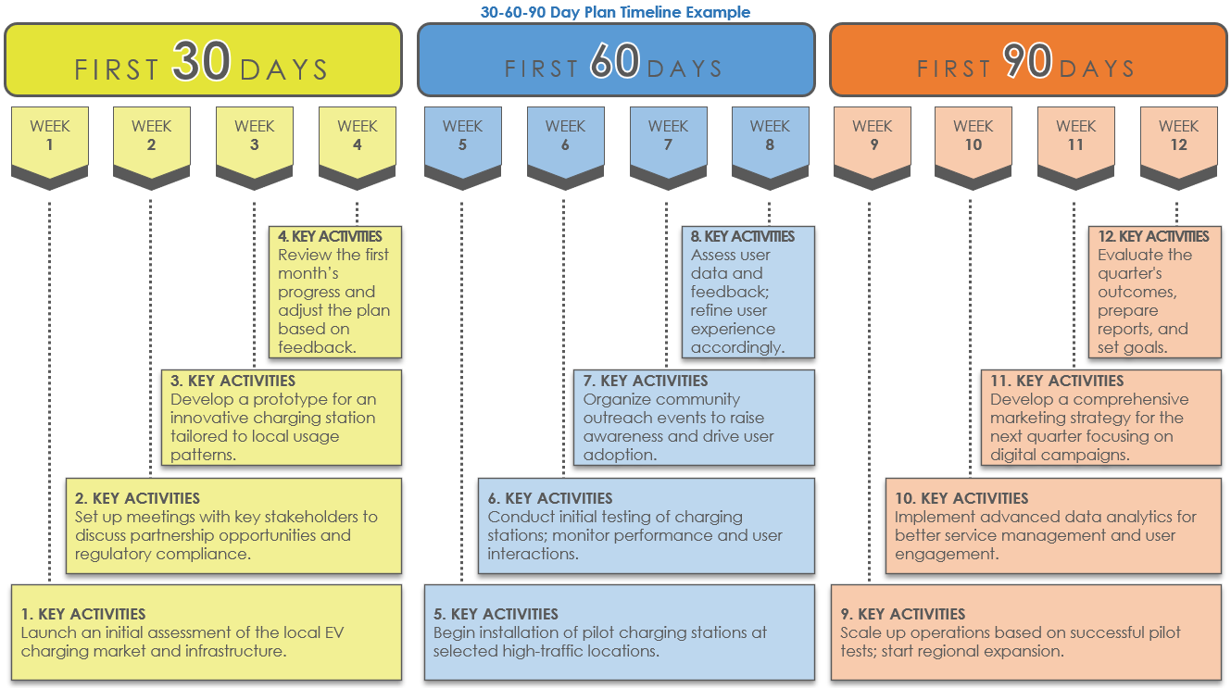
PowerPoint 30-60-90 Day Plan
Timeline Template Example
When to Use This Template: Use this template to create a detailed plan for key activities during the critical first 30, 60, and 90 days of your project.
Notable Template Features: This template simplifies the process of setting and tracking key project activities and goals for 30, 60, and 90 days in a single slide. It allows the user to make precise adjustments to task durations and create a clear visualization of milestones. The template also includes sample text for each stage for additional guidance.

Slide 2
30-60-90 Day Plan Timeline Example
FIRST 30 DAYS
FIRST 60 DAYS
FIRST 90 DAYS
WEEK
1
WEEK
2
WEEK
3
WEEK
4
WEEK
5
WEEK
6
WEEK
7
WEEK
8
WEEK
9
WEEK 10
WEEK 11
WEEK 12
4. KEY ACTIVITIES
Review the first month’s progress and adjust the plan based on feedback.
8. KEY ACTIVITIES
Assess user data and feedback; refine user experience accordingly.
12. KEY ACTIVITIES
Evaluate the quarter's outcomes, prepare reports, and set goals.
3. KEY ACTIVITIES
Develop a prototype for an innovative charging station tailored to local usage patterns.
7. KEY ACTIVITIES
Organize community outreach events to raise awareness and drive user adoption.
11. KEY ACTIVITIES
Develop a comprehensive marketing strategy for the next quarter focusing on digital campaigns.
2. KEY ACTIVITIES
Set up meetings with key stakeholders to discuss partnership opportunities and regulatory compliance.
6. KEY ACTIVITIES
Conduct initial testing of charging stations; monitor performance and user interactions.
10. KEY ACTIVITIES
Implement advanced data analytics for better service management and user engagement.
1. KEY ACTIVITIES
Launch an initial assessment of the local EV charging market and infrastructure.
5. KEY ACTIVITIES
Begin installation of pilot charging stations at selected high-traffic locations.
9. KEY ACTIVITIES
Scale up operations based on successful pilot tests; start regional expansion.

Slide 3
FIRST 30 DAYS
FIRST 60 DAYS
FIRST 90 DAYS
WEEK
1
WEEK
2
WEEK
3
WEEK
4
WEEK
5
WEEK
6
WEEK
7
WEEK
8
WEEK
9
WEEK 10
WEEK 11
WEEK 12
4. KEY ACTIVITIES
Compile a monthly review of goals met and outline adjustments needed.
8. KEY ACTIVITIES
Evaluate progress against project benchmarks.
12. KEY ACTIVITIES
Prepare a detailed report on outcomes and future proposals.
3. KEY ACTIVITIES
Focus on refining strategies based on initial feedback.
7. KEY ACTIVITIES
Address challenges and engage more deeply with key stakeholders.
11. KEY ACTIVITIES
Finalize all project components and gather feedback.
2. KEY ACTIVITIES
Document key interactions and early achievements.
6. KEY ACTIVITIES
Strengthen collaborations and check progress against targets.
10. KEY ACTIVITIES
Start wrapping up the main project deliverables and begin final assessments.
1. KEY ACTIVITIES
Enter the initial setup tasks to establish the groundwork for the project.
5. KEY ACTIVITIES
Begin implementing more complex project elements.
9. KEY ACTIVITIES
Initiate the final phase implementations and critical evaluations.

Slide 4
DISCLAIMER Any articles, templates, or information provided by Smartsheet on the website are for reference only. While we strive to keep the information up to date and correct, we make no representations or warranties of any kind, express or implied, about the completeness, accuracy, reliability, suitability, or availability with respect to the website or the information, articles, templates, or related graphics contained on the website. Any reliance you place on such information is therefore strictly at your own risk.

