Slide 1

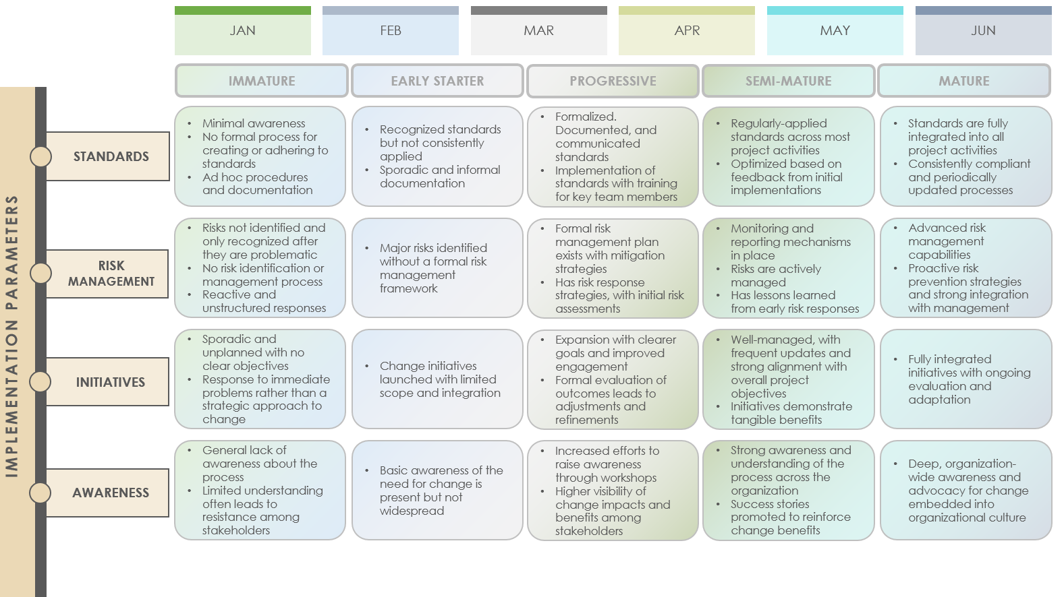
Change Management Maturity Roadmap Template Example

Slide 2
 | JAN |  |  |  | FEB |  |  |  | MAR |  |  |  | APR |  |  |  | MAY |  |  |  | JUN
IMMATURE
EARLY STARTER
PROGRESSIVE
SEMI-MATURE
MATURE
Minimal awareness
No formal process for creating or adhering to standards
Ad hoc procedures and documentation
Recognized standards but not consistently applied
Sporadic and informal documentation
Formalized. Documented, and communicated standards
Implementation of standards with training for key team members
Regularly-applied standards across most project activities
Optimized based on feedback from initial implementations
Standards are fully integrated into all project activities
Consistently compliant and periodically updated processes
STANDARDS
Risks not identified and only recognized after they are problematic
No risk identification or management process
Reactive and unstructured responses
Major risks identified without a formal risk management framework
Formal risk management plan exists with mitigation strategies
Has risk response strategies, with initial risk assessments
Monitoring and reporting mechanisms in place
Risks are actively managed
Has lessons learned from early risk responses
Advanced risk management capabilities
Proactive risk prevention strategies and strong integration with management
RISK MANAGEMENT
IMPLEMENTATION PARAMETERS
Sporadic and unplanned with no clear objectives
Response to immediate problems rather than a strategic approach to change
Change initiatives launched with limited scope and integration
Expansion with clearer goals and improved engagement
Formal evaluation of outcomes leads to adjustments and refinements
Well-managed, with frequent updates and strong alignment with overall project objectives
Initiatives demonstrate tangible benefits
Fully integrated initiatives with ongoing evaluation and adaptation
INITIATIVES
General lack of awareness about the process
Limited understanding often leads to resistance among stakeholders
Basic awareness of the need for change is present but not widespread
Increased efforts to raise awareness through workshops
Higher visibility of change impacts and benefits among stakeholders
Strong awareness and understanding of the process across the organization
Success stories promoted to reinforce change benefits
Deep, organization-wide awareness and advocacy for change embedded into organizational culture
AWARENESS
Change Management Maturity Roadmap Template Example

Slide 3
DISCLAIMER Any articles, templates, or information provided by Smartsheet on the website are for reference only. While we strive to keep the information up to date and correct, we make no representations or warranties of any kind, express or implied, about the completeness, accuracy, reliability, suitability, or availability with respect to the website or the information, articles, templates, or related graphics contained on the website. Any reliance you place on such information is therefore strictly at your own risk.

