Slide 1
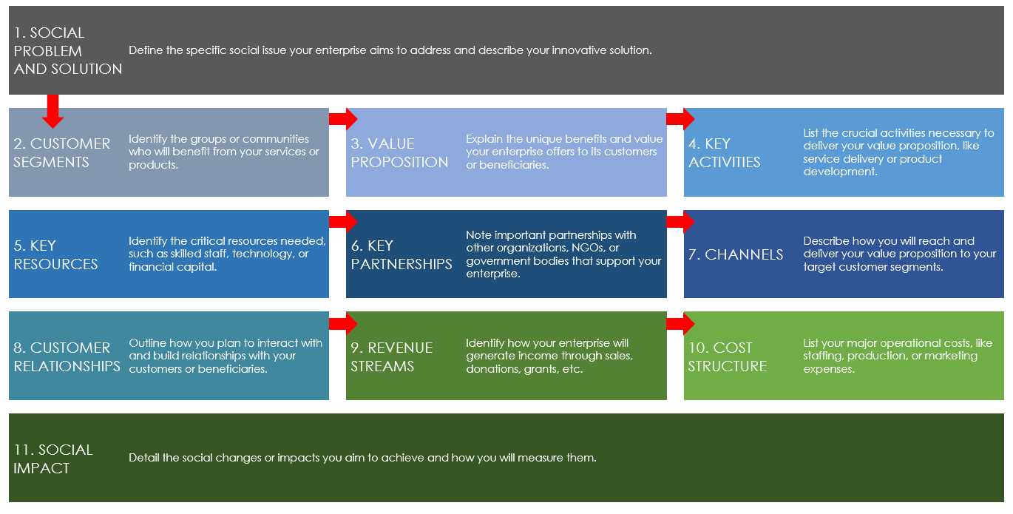
SOCIAL ENTERPRISE CANVAS TEMPLATE EXAMPLE for PowerPoint
These instructions will guide you in creating a comprehensive business model for your social enterprise, aligning your social goals with sustainable business practices.

Slide 2
SOCIAL ENTERPRISE BUSINESS MODEL CANVAS TEMPLATE EXAMPLE
1. SOCIAL PROBLEM AND SOLUTION | Problem: Urban areas face significant challenges in reducing carbon emissions because municipal transportation is highly dependent on non-renewable energy. Solution: Positive Charge aims to address this problem by providing widely accessible and efficient electric vehicle (EV) charging solutions, encouraging the shift toward electric transportation.
2. CUSTOMER SEGMENTS | Primary customers include electric vehicle owners in urban and suburban areas. Secondary customers encompass local government bodies looking to reduce urban pollution. |  | 3. VALUE PROPOSITION | We offer convenient, fast-charging stations that are strategically located throughout the city so as to minimize range anxiety for EV owners. We provide subscription-based services with premium options for faster charging speeds. |  | 4. KEY ACTIVITIES | Install and maintain a network of high-efficiency EV charging stations. Develop partnerships with retailers in order to install charging stations. Conduct community outreach to promote EV adoption.
5. KEY RESOURCES | We need a team of skilled technicians who specialize in high-voltage. electrical installations and renewable energy solutions. We need to partner with energy suppliers to ensure that there is a reliable supply of green energy. |  | 6. KEY PARTNERSHIPS | We collaborate with local businesses and shopping centers to host charging stations. We partner with municipal governments to integrate charging stations into public transport areas and gain permission for installations. |  | 7. CHANNELS | Achieve direct outreach through local events and partnerships with eco-friendly organizations. Run social media campaigns that focus on environmental benefits and convenience.
8. CUSTOMER RELATIONSHIPS | We will maintain customer engagement through an app that allows users to find the nearest charger, reserve a charging slot, and manage their subscription. We will offer 24/7 customer support. |  | 9. REVENUE STREAMS | We generate revenue through monthly subscriptions that grant users unlimited charging access. We also generate income from pay-per-charge services for occasional users. |  | 10. COST STRUCTURE | Major costs include the installation of charging stations, maintenance, software development, and marketing. Operational costs are partly offset by government grants and incentives for promoting green energy solutions.
11. SOCIAL IMPACT | We aim to reduce urban carbon emissions by making EV charging more accessible, thus accelerating the transition to electric vehicles. We measure our impact via the number of charging stations we install, the increase in EV usage in operational areas, and the reduction in greenhouse gases.

Slide 3
DISCLAIMER Any articles, templates, or information provided by Smartsheet on the website are for reference only. While we strive to keep the information up to date and correct, we make no representations or warranties of any kind, express or implied, about the completeness, accuracy, reliability, suitability, or availability with respect to the website or the information, articles, templates, or related graphics contained on the website. Any reliance you place on such information is therefore strictly at your own risk.

