Slide 1


PowerPoint Corporate Event Proposal Template Example
20XX GLOBAL INNOVATORS SUMMIT
Event Date: AUGUST 21-23, 20XX
INNOVATORS 20XX

Slide 2

CONTENTS
1
CORPORATE EVENT OVERVIEW
6
MARKETING STRATEGY
2
7
SPONSORSHIP PACKAGE OPTIONS
OBJECTIVES AND GOALS
8
SUCCESS STORIES AND TESTIMONIALS
3
DETAILED AGENDA
4
9
CONTACT INFORMATION AND ENGAGEMENT CALL TO ACTION
VENUE SELECTION
AND LAYOUT
5
BUDGET BREAKDOWN

Slide 3
1. CORPORATE EVENT OVERVIEW
Event Sequence
STAGE 1
Arrival
STAGE 2
Keynote
Introducing the annual summit for global innovation leaders to discuss technology, sustainability, and future market trends. A premier event attracting thought leaders, policymakers, and pioneers.
STAGE 3
Panels
STAGE 4
Networking
STAGE 5
Banquet
STAGE 6
Close
Build a flow chart that aligns with the hierarchy of your event structure, illustrating the event’s flow.

Slide 4
2. OBJECTIVES AND GOALS
GOAL 1 | Establish a platform for innovation dialogue
GOAL 2 | Launch new industry collaborations
GOAL 3 | Showcase groundbreaking projects
GOAL 4

Slide 5
3. DETAILED AGENDA
TASKS | Early a.m. | Late a.m. | Mid-day | Afternoon | Late Afternoon | Evening
Session 1 – Morning Keynote
Session 2 – Breakout Sessions
Session 3 – Gala for Networking
Banquet
Close
8 AM-11 AM
1 PM-2 PM
2 PM-3 PM
3 PM – 5 PM
5 PM
Tech Giants
Industry Professionals
VP of Engagement
Title or Owner
Industry Professionals
All Attendees
Title or Owner
Title or Owner

Slide 6


4. VENUE AND LAYOUT
Description of the Metropolitan Convention Center, detailing the grand auditorium, breakout rooms, and exhibition space.
Replace with images, layouts, and photos related to your event venue and layout.

Slide 7
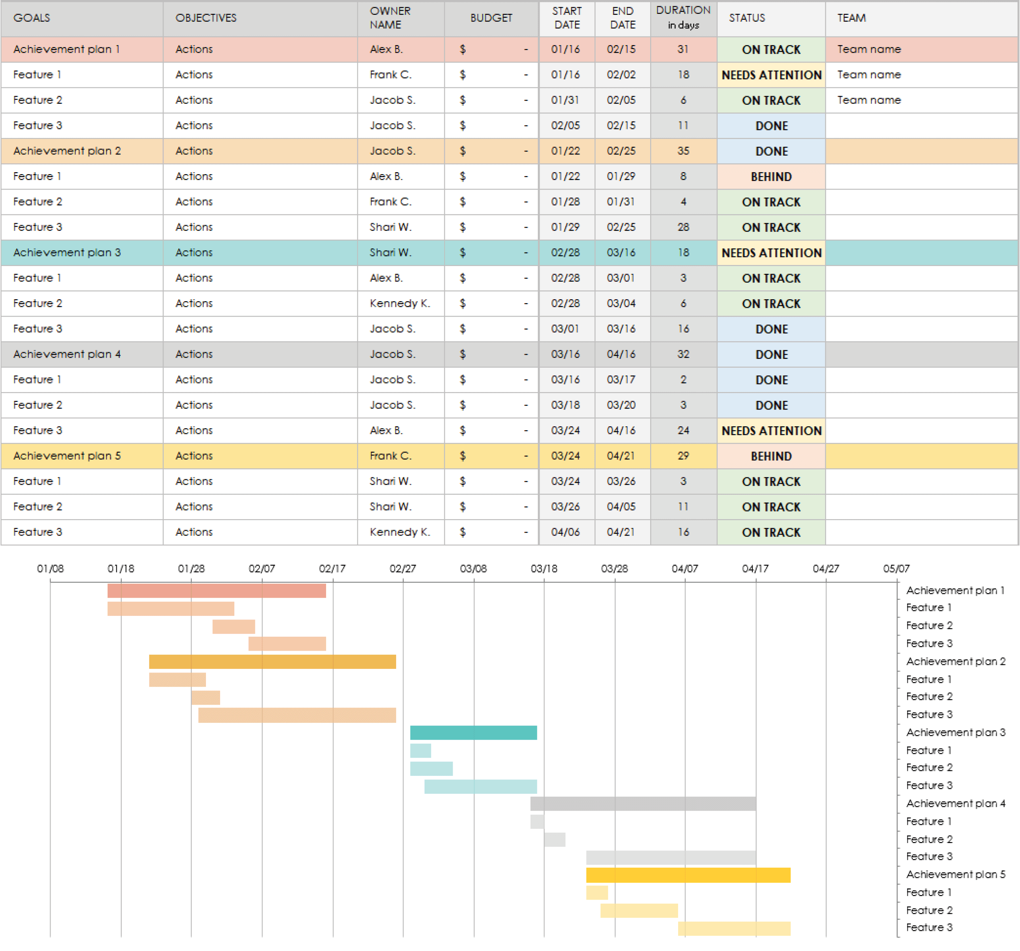
5. BUDGET BREAKDOWN
Allocation for keynote speaker fees, venue hire, technological setup, catering, and marketing.
Build your event budget spreadsheet in Excel, with tables, charts, etc. Then, embed the file here and/or include a static image of the Excel spreadsheet.

Slide 8


6. MARKETING STRATEGY
Strategy includes social media campaigns, industry magazine features, and partnership announcements.
Replace with images or videos of promotional materials directly related to your marketing plan.

Slide 9
7. SPONSORSHIP PACKAGE OPTIONS
Outline various sponsorship packages, including benefits for each level.
PACKAGE A | Innovators Sponsorship level – package details
PACKAGE B | Pioneer Sponsorship level – package details
PACKAGE C | Visionary Sponsorship level – package details
PACKAGE D | Leaders Sponsorship level – package details

Slide 10





8. SUCCESS STORIES AND TESTIMONIALS
Include testimonials from past event sponsors, attendees, or keynote speakers.
This event was valuable and a great experience.
Sponsoring was rewarding and benefited our growing partnerships.
- Lucy G., Attendee
This was a memorable experience – and I look forward to future events.
- Bernie W., Package B Sponsor
- Romy B., Attendee

Slide 11
9. CONTACT INFORMATION AND ENGAGEMENT CALL-TO-ACTION
Detail how to engage, including sponsorship inquiries or registration details…
EVENT TITLE
Event Date: MM/DD/YY
Website
Social Media Information
Person of Contact: Joe Girardi, VP of Engagement
Phone
Email
Address
Insert QR code
YOUR LOGO HERE

Slide 12
DISCLAIMER Any articles, templates, or information provided by Smartsheet on the website are for reference only. While we strive to keep the information up to date and correct, we make no representations or warranties of any kind, express or implied, about the completeness, accuracy, reliability, suitability, or availability with respect to the website or the information, articles, templates, or related graphics contained on the website. Any reliance you place on such information is therefore strictly at your own risk.

