Slide 1


PowerPoint Arts and Music Event Proposal Template Example
RHYTHM & HUES: Music and Art Fusion Festival
Submission Date: MM/DD/YY
Your logo here

Slide 2

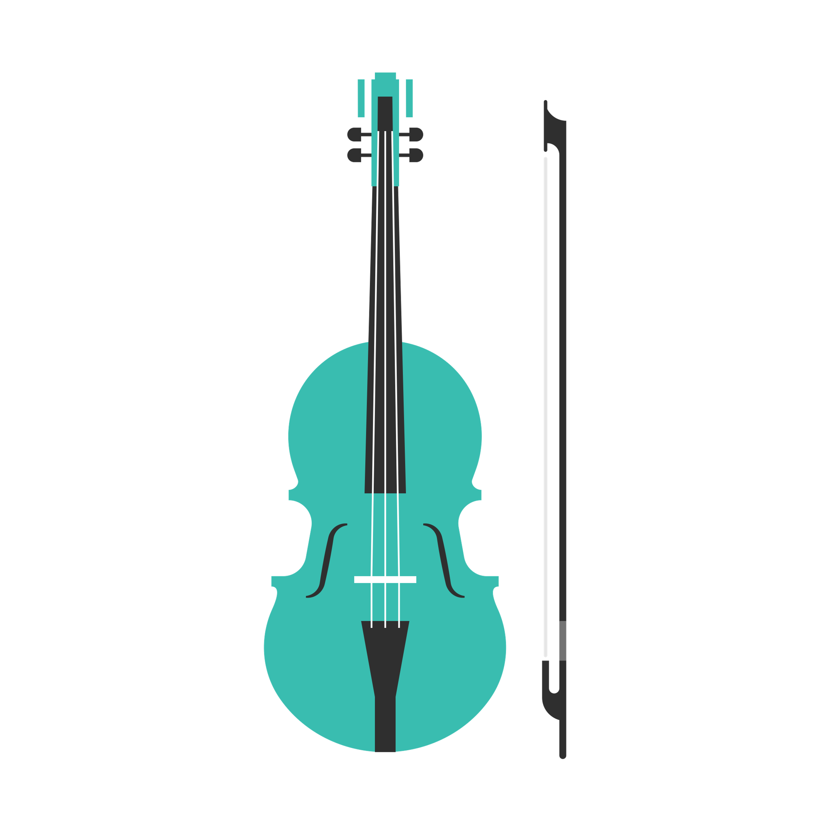
CONTENTS
1
EVENT CONCEPT
AND THEME
6
MARKETING AND OUTREACH STRATEGY
2
TARGET AUDIENCE AND COMMUNITY IMPACT
7
SPONSORSHIP OPPORTUNITIES
8
BUDGET OVERVIEW
3
FEATURED ARTISTS
AND PERFORMANCES
4
VENUE AND ATMOSPHERE
9
PAST EVENT SUCCESSES
5
SCHEDULE OF EVENTS
10
CLOSING AND
CALL TO ACTION

Slide 3

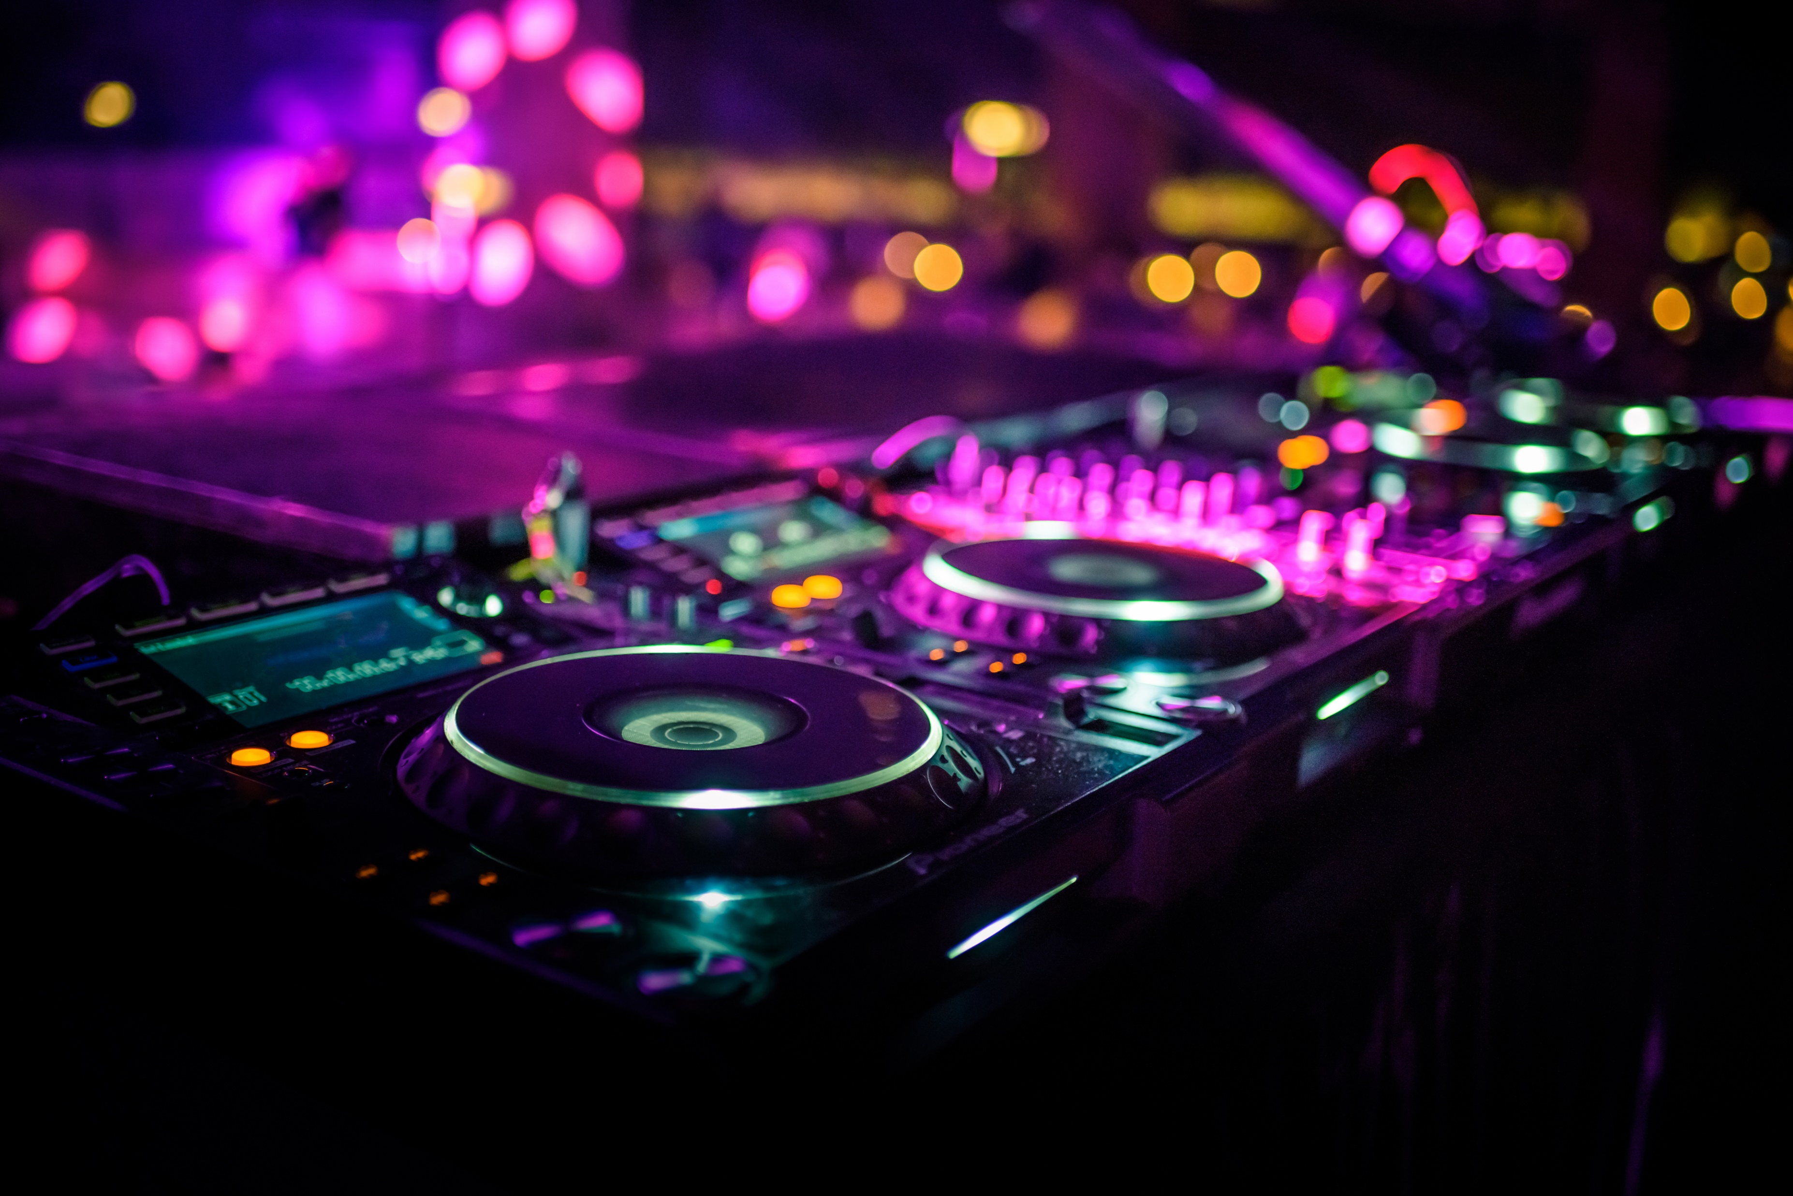
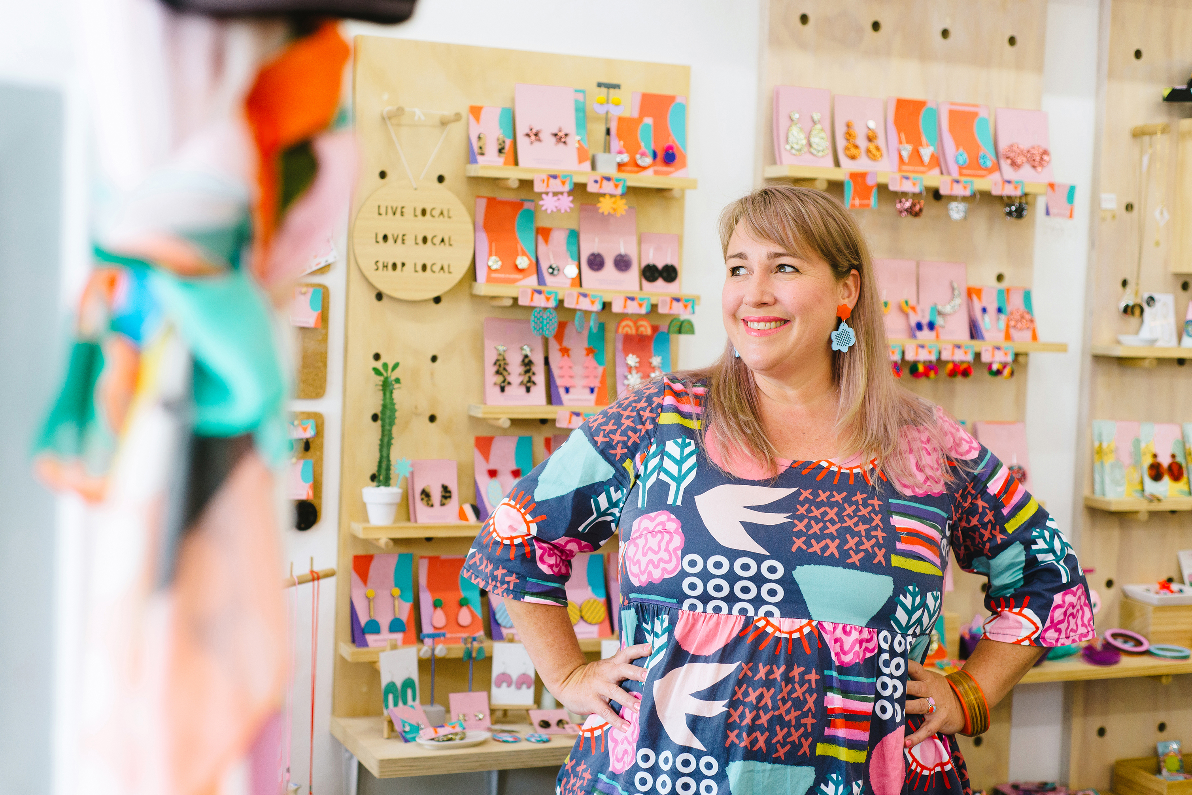

1. EVENT CONCEPT AND THEME
Welcome to "Rhythm and Hues," a proposal for a unique festival that combines exhilarating musical performances with captivating visual art displays. Designed for promoters and organizers of cultural events, this template outlines a comprehensive framework to ensure the successful execution of a culturally enriching festival.
Concept: A two-day outdoor festival that blends live music performances with interactive art installations, creating a sensory experience that celebrates creativity and community.
Proposed Dates: July 14-15, 20XX
Location: Greenfield Park, Downtown Metropolis
Objectives: To foster a deeper appreciation for music and visual arts within the community, encourage participation from local and national artists, and provide a platform for emerging talent.

Slide 4

2. TARGET AUDIENCE
The festival aims to attract a diverse crowd with its eclectic mix of genres and art forms.
TARGET AUDIENCE | DEMOGRAPHICS | IMPACTS ON THE LOCAL ARTS COMMUNITY
Art lovers | 10-45 Families Tourists seeking cultural experiences | Description Description
Music lovers | 10-45 Families Tourists seeking cultural experiences Students from nearby colleges | Description Description

Slide 5

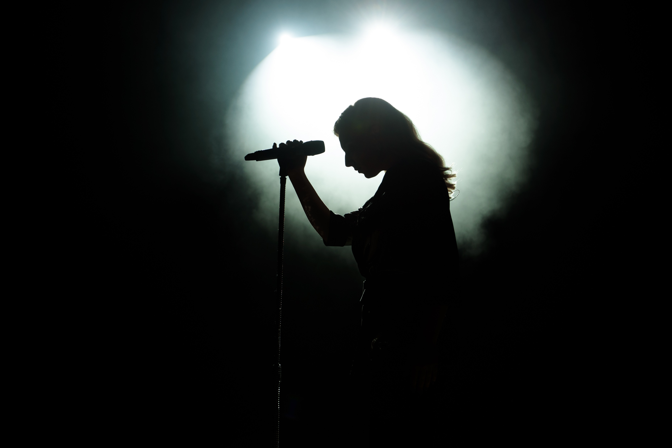

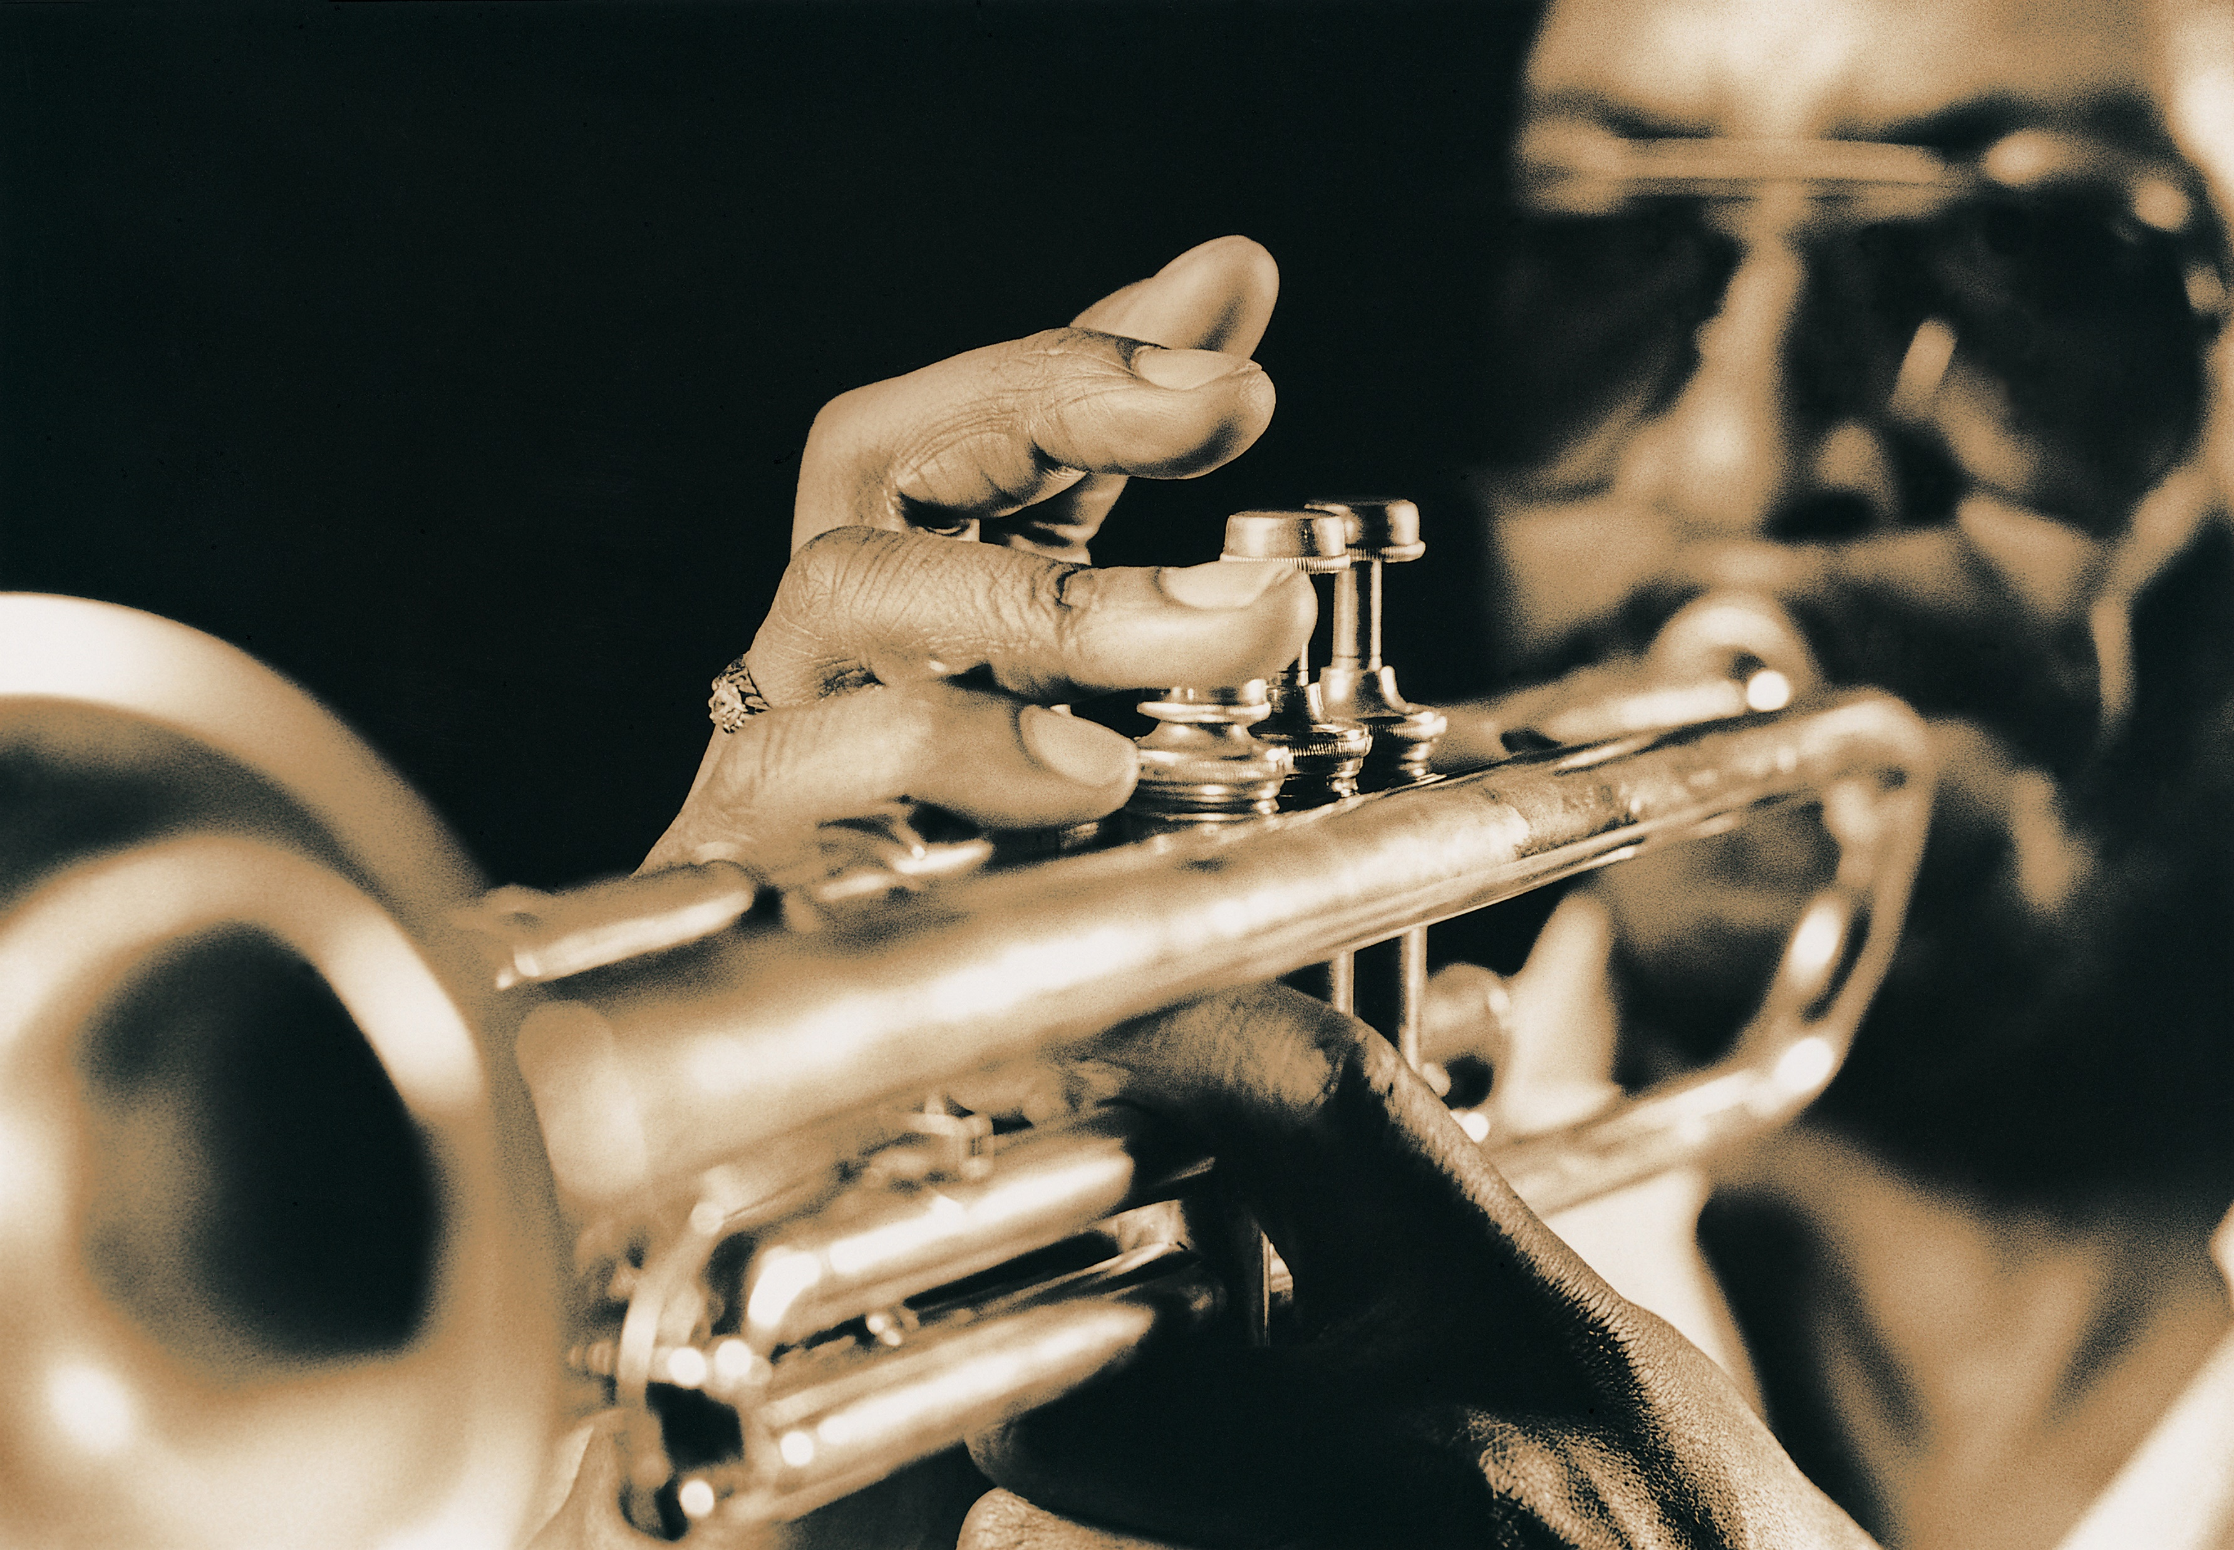
3. FEATURED ARTISTS AND PERFORMERS
The Azure Band
Pottery and Sculpture
by Roger R.
The Eclipse Trio
Indie rock group with a vibrant sound – headline performer
Traditional jazz meets electronic beats – late night dance set
Interactive light sculpture garden – evening attraction

Slide 6
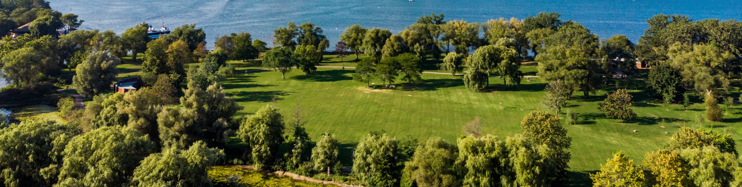
4. VENUE AND ATMOSPHERE
Greenfield Park - Offers a natural amphitheater setting, art exhibit space, and vendor areas.
AREA A is for show tents
AREA B is for art vendors
AREA C is for food vendors and tables

Slide 7
5. SCHEDULE OF EVENTS
TODAY
TASKS | DAY 1 | DAY 2 | DAY 3 | DAY 4 | DAY 5 | DAY 6
Event 1
Event 2
Performer 3
Performer 4
Workshop 5
Workshop 6
Event 7
Event 8
Event 9
Event 10
Due 00/00
Due 00/00
Milestone 1
Needs Review
Milestone 1 – 00/00
Due 00/00
Due 00/00
Due 00/00
Due 00/00
Due 00/00
Task Owner 1
Task Owner 3
Task Owner 5
Task Owner 7
Task Owner 2
Task Owner 4
Task Owner 6
Task Owner 8

Slide 8

6. MARKETING AND OUTREACH STRATEGY
Utilize social media campaigns, local radio partnerships, and art influencer collaborations to generate buzz. Promotional materials include vibrant posters, teaser videos featuring artists and performers, and early bird ticket promotions.

Slide 9

7. SPONSORSHIP OPPORTUNITIES
Various sponsorship levels with corresponding benefits, tailored to arts and music supporters.
SPONSORSHIP LEVEL | BENEFITS
PLATINUM SPONSOR | $50,000 Main stage naming rights VIP hospitality suite Extensive brand visibility
GOLD SPONSOR | $25,000 Secondary stage sponsorship Branded lounge area Social media shoutouts
LEVEL C | Description Description
LEVEL D | Description Description
LEVEL E | Description Description

Slide 10
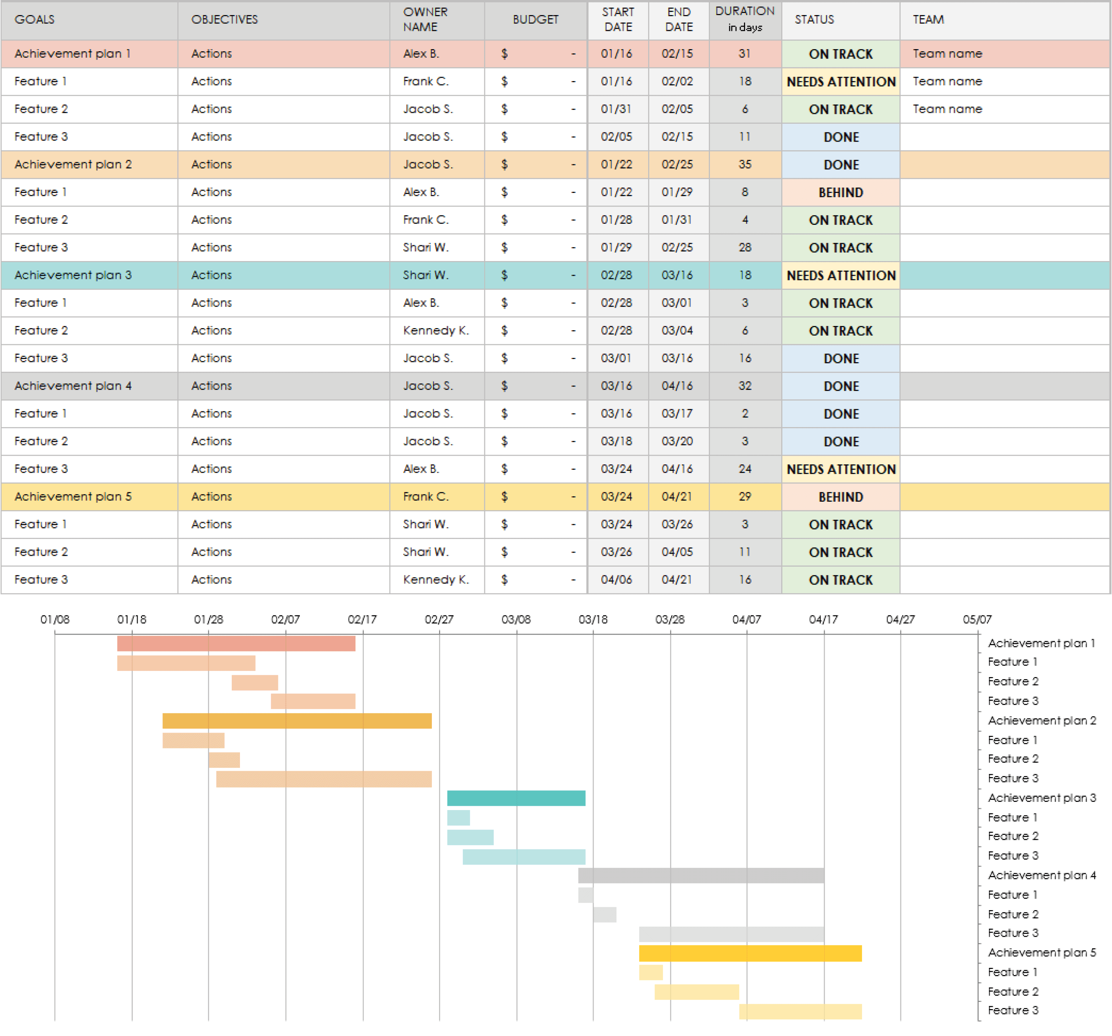
8. BUDGET OVERVIEW
Build your itemized event budget spreadsheet in Excel, with tables, charts, etc. Then, embed the file here and/or include a static image of the Excel spreadsheet. Include flexible options based on the scale of the event.

Slide 11



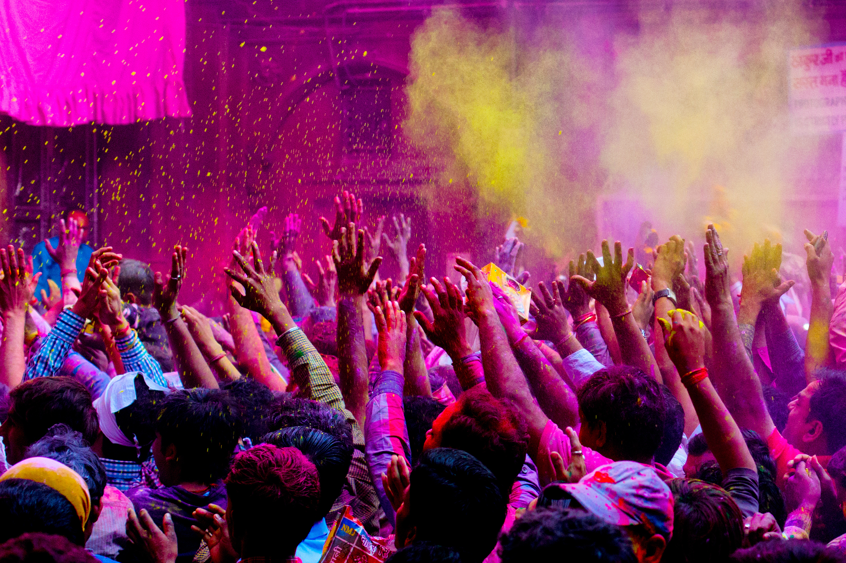
9. PAST EVENT SUCCESSES
20XX’s event was a wild success, both from ticket sales and event engagement.
- Romy B., Event Performer

Slide 12

10. CLOSING AND CALL TO ACTION
Please review this proposal and share any feedback or adjustments needed. Upon approval, Harmonic Events LLC is ready to proceed with detailed planning and execution phases.
Website
Social Media Information
Person of Contact: Name, Title
Phone
Email
Address
Insert QR code
Your logo here

Slide 13
DISCLAIMER Any articles, templates, or information provided by Smartsheet on the website are for reference only. While we strive to keep the information up to date and correct, we make no representations or warranties of any kind, express or implied, about the completeness, accuracy, reliability, suitability, or availability with respect to the website or the information, articles, templates, or related graphics contained on the website. Any reliance you place on such information is therefore strictly at your own risk.

