Slide 1


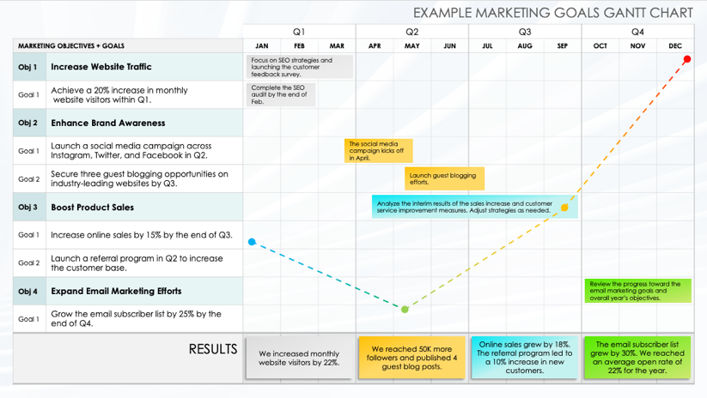
Marketing Goals Gantt Chart Template
When to Use This Template: Use this Gantt chart template with or without sample data to track quarterly marketing objectives and goals. Teams can visualize their progress over the year, aligning tasks and milestones with specific quarters for focused execution. Add this slide to a presentation deck for meetings and reviews.
Notable Template Features: This Gantt chart is divided into four quarters for planning and tracking objectives and goals throughout the year. Users can adjust task durations, add milestones, and summarize results directly in the chart, facilitating a comprehensive overview of marketing efforts and achievements.
Notes for Using This Template: Enter Objectives and Goals in the chart area. Adjust bars for each task to represent the length of time. Add Milestone Dates and additional information within each bar or in the graph area. Summarize results in the bottom row.

Slide 2
MARKETING GOALS GANTT CHART
 |  | Q1 |  |  | Q2 |  |  | Q3 |  |  | Q4
MARKETING OBJECTIVES + GOALS |  | JAN | FEB | MAR | APR | MAY | JUN | JUL | AUG | SEP | OCT | NOV | DEC
RESULTS

Slide 3
EXAMPLE MARKETING GOALS GANTT CHART
 |  | Q1 |  |  | Q2 |  |  | Q3 |  |  | Q4
MARKETING OBJECTIVES + GOALS |  | JAN | FEB | MAR | APR | MAY | JUN | JUL | AUG | SEP | OCT | NOV | DEC
Obj 1 | Increase Website Traffic
Goal 1 | Achieve a 20% increase in monthly website visitors within Q1.
Obj 2 | Enhance Brand Awareness
Goal 1 | Launch a social media campaign across Instagram, Twitter, and Facebook in Q2.
Goal 2 | Secure three guest blogging opportunities on industry-leading websites by Q3.
Obj 3 | Boost Product Sales
Goal 1 | Increase online sales by 15% by the end of Q3.
Goal 2 | Launch a referral program in Q2 to increase the customer base.
Obj 4 | Expand Email Marketing Efforts
Goal 1 | Grow the email subscriber list by 25% by the end of Q4.
RESULTS
Focus on SEO strategies and launching the customer feedback survey.
Complete the SEO audit by the end of Feb.
The social media campaign kicks off in April.
Launch guest blogging efforts.
Analyze the interim results of the sales increase and customer service improvement measures. Adjust strategies as needed.
Review the progress toward the email marketing goals and overall year’s objectives.
We increased monthly website visitors by 22%.
We reached 50K more followers and published 4 guest blog posts.
Online sales grew by 18%. The referral program led to a 10% increase in new customers.
The email subscriber list grew by 30%. We reached an average open rate of 22% for the year.

Slide 4
DISCLAIMER Any articles, templates, or information provided by Smartsheet on the website are for reference only. While we strive to keep the information up to date and correct, we make no representations or warranties of any kind, express or implied, about the completeness, accuracy, reliability, suitability, or availability with respect to the website or the information, articles, templates, or related graphics contained on the website. Any reliance you place on such information is therefore strictly at your own risk.

