Slide 1
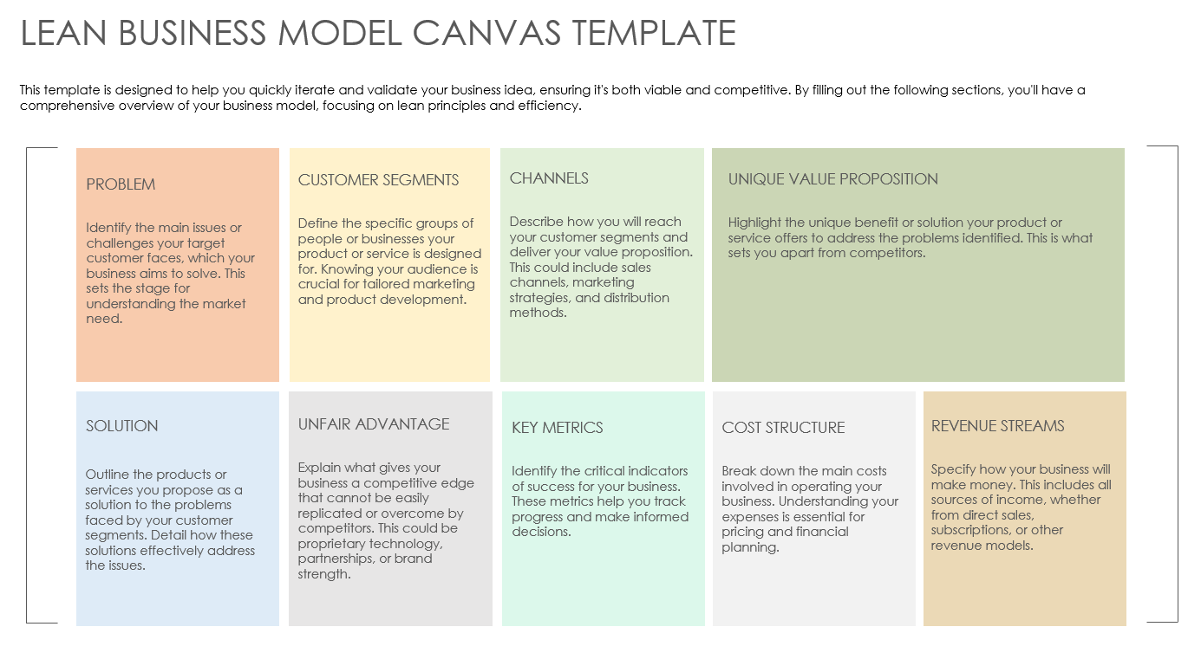
LEAN BUSINESS MODEL CANVAS TEMPLATE EXAMPLE for PowerPoint

Slide 2
LEAN BUSINESS MODEL CANVAS TEMPLATE EXAMPLE
By focusing on these key aspects, Positive Charge aims to address the growing need for accessible and efficient electric vehicle (EV) charging solutions, ensuring a seamless experience for EV owners and commercial fleets alike:
PROBLEM
CUSTOMER SEGMENTS
CHANNELS
UNIQUE VALUE PROPOSITION
Many EV owners find it challenging to locate reliable and fast charging stations, especially during long trips across less urban areas.
Our primary customers include EV owners, particularly those who frequently travel long distances, and commercial EV fleets looking for efficient charging solutions.
We'll reach our customers through partnerships with EV manufacturers, targeted digital marketing campaigns, and the establishment of charging stations at strategic locations like shopping centers and highway rest stops.
Positive Charge offers the fastest charging technology on the market, ensuring that EV owners and commercial fleets minimize downtime and enjoy longer travel ranges with shorter charging breaks.
SOLUTION
UNFAIR ADVANTAGE
KEY METRICS
COST STRUCTURE
REVENUE STREAMS
We provide an extensive network of ultra-fast, reliable EV charging stations, complemented by a user-friendly app that offers real-time availability, reservations, and customer support.
Our proprietary, ultra-fast charging technology, exclusive partnerships with major commercial parking lots, and first-mover advantage in several underserved regions give us a competitive edge.
Key performance indicators include the number of charging sessions per day, customer acquisition growth, the number of app downloads and active users, and the average revenue per charging session.
Major costs involve the installation and maintenance of charging stations, technology development, marketing and advertising, and operations management.
Revenue is generated via service fees, subscription models for frequent users and commercial fleets, and partnerships with local businesses that drive traffic to charging station locations.

Slide 3
DISCLAIMER Any articles, templates, or information provided by Smartsheet on the website are for reference only. While we strive to keep the information up to date and correct, we make no representations or warranties of any kind, express or implied, about the completeness, accuracy, reliability, suitability, or availability with respect to the website or the information, articles, templates, or related graphics contained on the website. Any reliance you place on such information is therefore strictly at your own risk.

