Slide 1

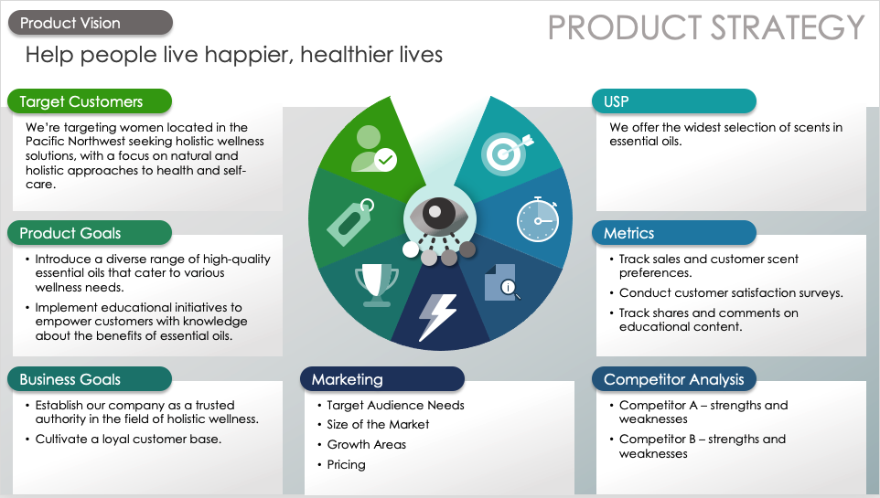
Product Strategy PowerPoint Template
When to Use This Template: This single slide template is ideal for product managers who need to present a clear and visually appealing product strategy. Download the version with sample copy for guidance on what to include to deliver an effective product strategy.
Notable Template Features: This template features customizable strategy themes that support the product vision. Fill in each theme and include a brief description to communicate the product strategy to your team.

Slide 2
Product Vision
PRODUCT STRATEGY
Text
Target Customers
USP
Text
Text
Product Goals
Metrics
Text
Text
Business Goals
Marketing
Competitor Analysis
Text
Text
Competitor A –
strengths and weaknesses
Competitor B –
strengths and weaknesses

Slide 3
Product Vision
PRODUCT STRATEGY
EXAMPLE
Help people live happier, healthier lives
Target Customers
USP
We’re targeting women located in the Pacific Northwest seeking holistic wellness solutions, with a focus on natural and holistic approaches to health and self-care.
We offer the widest selection of scents in essential oils.
Product Goals
Metrics
Introduce a diverse range of high-quality essential oils that cater to various wellness needs.
Implement educational initiatives to empower customers with knowledge about the benefits of essential oils.
Track sales and customer scent preferences.
Conduct customer satisfaction surveys.
Track shares and comments on educational content.
Business Goals
Marketing
Competitor Analysis
Establish our company as a trusted authority in the field of holistic wellness.
Cultivate a loyal customer base.
Target Audience Needs
Size of the Market
Growth Areas
Pricing
Competitor A –
strengths and weaknesses
Competitor B –
strengths and weaknesses

Slide 4
DISCLAIMER Any articles, templates, or information provided by Smartsheet on the website are for reference only. While we strive to keep the information up to date and correct, we make no representations or warranties of any kind, express or implied, about the completeness, accuracy, reliability, suitability, or availability with respect to the website or the information, articles, templates, or related graphics contained on the website. Any reliance you place on such information is therefore strictly at your own risk.

