Slide 1

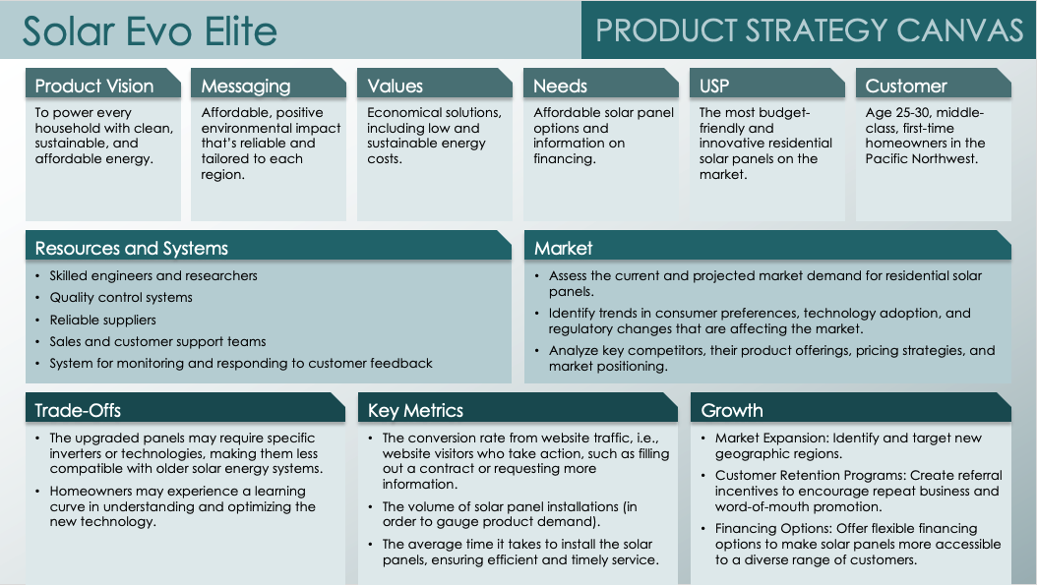
PRODUCT STRATEGY CANVAS TEMPLATE – EXAMPLE
When to Use This Template: Use this template with or without sample data when your product team needs a one-page, high-level view of a product strategy. The product strategy canvas is a great tool for visualizing the connections between various elements of product strategy.
Notable Template Features: This template allows managers to illustrate how key product strategy elements reinforce one another, enabling them to build a foundation for product development. It includes sections for describing the product vision, trade-offs, resources and systems, growth plan, and more.

Slide 2
Solar Evo Elite
PRODUCT STRATEGY CANVAS
Product Vision
Messaging
Values
Needs
USP
Customer
To power every household with clean, sustainable, and affordable energy.
Affordable, positive environmental impact that’s reliable and tailored to each region.
Economical solutions, including low and sustainable energy costs.
Affordable solar panel options and information on financing.
The most budget-friendly and innovative residential solar panels on the market.
Age 25-30, middle-class, first-time homeowners in the Pacific Northwest.
Resources and Systems
Market
Skilled engineers and researchers
Quality control systems
Reliable suppliers
Sales and customer support teams
System for monitoring and responding to customer feedback
Assess the current and projected market demand for residential solar panels.
Identify trends in consumer preferences, technology adoption, and regulatory changes that are affecting the market.
Analyze key competitors, their product offerings, pricing strategies, and market positioning.
Trade-Offs
Key Metrics
Growth
The upgraded panels may require specific inverters or technologies, making them less compatible with older solar energy systems.
Homeowners may experience a learning curve in understanding and optimizing the new technology.
The conversion rate from website traffic, i.e., website visitors who take action, such as filling out a contract or requesting more information.
The volume of solar panel installations (in order to gauge product demand).
The average time it takes to install the solar panels, ensuring efficient and timely service.
Market Expansion: Identify and target new geographic regions.
Customer Retention Programs: Create referral incentives to encourage repeat business and word-of-mouth promotion.
Financing Options: Offer flexible financing options to make solar panels more accessible to a diverse range of customers.

Slide 3
Product Name
PRODUCT STRATEGY CANVAS
Product Vision
Messaging
Values
Needs
USP
Customer
Text
Text
Text
Text
Text
Text
Resources and Systems
Market
Text
Text
Trade-Offs
Key Metrics
Growth
Text
Text
Text

Slide 4
DISCLAIMER Any articles, templates, or information provided by Smartsheet on the website are for reference only. While we strive to keep the information up to date and correct, we make no representations or warranties of any kind, express or implied, about the completeness, accuracy, reliability, suitability, or availability with respect to the website or the information, articles, templates, or related graphics contained on the website. Any reliance you place on such information is therefore strictly at your own risk.

