Slide 1

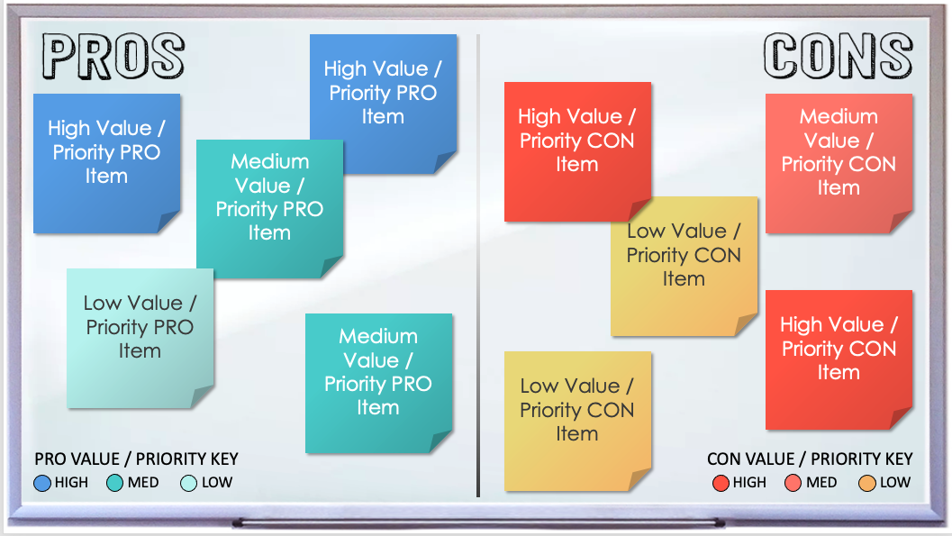
PROS AND CONS WHITEBOARD TEMPLATE for PowerPoint
When to Use This Template:
This pros and cons whiteboard template provides an organized visual aid for brainstorming sessions, allowing teams to collaboratively explore the advantages and disadvantages of various options.
Notable Template Features:
Use color-coded sticky notes to prioritize pros and cons based on importance. By visually mapping out the positives and negatives, teams can clearly identify potential risks and opportunities.

Slide 2



High Value / Priority PRO Item
High Value / Priority CON Item
High Value / Priority PRO Item
Medium Value / Priority CON Item
Medium Value / Priority PRO Item
Low Value / Priority CON Item
Low Value / Priority PRO Item
High Value / Priority CON Item
Medium Value / Priority PRO Item
Low Value / Priority CON Item
PRO VALUE / PRIORITY KEY
CON VALUE / PRIORITY KEY
HIGH MED LOW
HIGH MED LOW

Slide 3
DISCLAIMER Any articles, templates, or information provided by Smartsheet on the website are for reference only. While we strive to keep the information up to date and correct, we make no representations or warranties of any kind, express or implied, about the completeness, accuracy, reliability, suitability, or availability with respect to the website or the information, articles, templates, or related graphics contained on the website. Any reliance you place on such information is therefore strictly at your own risk.

