Slide 1
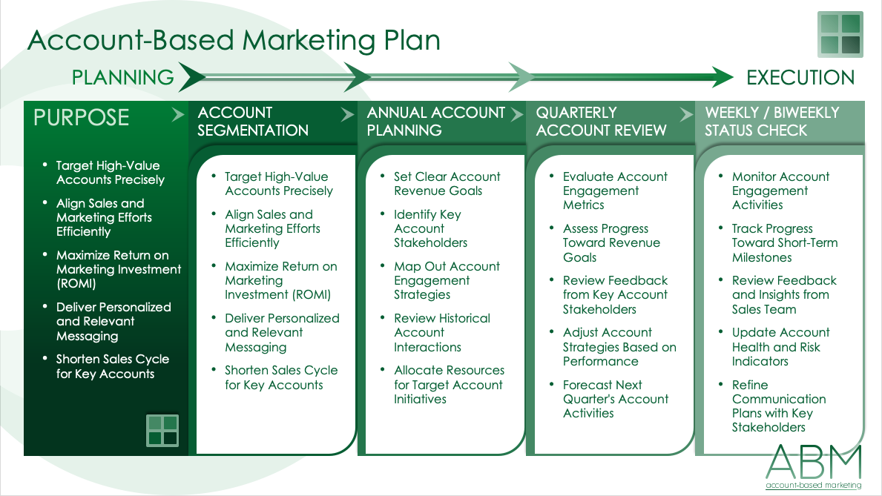
ACCOUNT-BASED MARKETING (ABM) PLAN TEMPLATE
This account-based marketing plan template is a roadmap for synchronizing your sales and marketing teams, ensuring they target high-value accounts with precision. By following the template's structured sections, from account segmentation and annual account planning to weekly status checks, both teams can collaboratively identify, engage, and convert prospects, maximizing their combined strengths.
For related resources that simplify the organization of key client information, check out these free client profile templates.

Slide 2
Account-Based Marketing Plan
PLANNING
EXECUTION
PURPOSE
ACCOUNT SEGMENTATION
ANNUAL ACCOUNT PLANNING
QUARTERLY ACCOUNT REVIEW
WEEKLY / BIWEEKLY STATUS CHECK
Text
Text
Text
Text
Text

Slide 3
Account-Based Marketing Plan – Example
PLANNING
EXECUTION
PURPOSE
ACCOUNT SEGMENTATION
ANNUAL ACCOUNT PLANNING
QUARTERLY ACCOUNT REVIEW
WEEKLY / BIWEEKLY STATUS CHECK
Target High-Value Accounts Precisely
Align Sales and Marketing Efforts Efficiently
Maximize Return on Marketing Investment (ROMI)
Deliver Personalized and Relevant Messaging
Shorten Sales Cycle for Key Accounts
Target High-Value Accounts Precisely
Align Sales and Marketing Efforts Efficiently
Maximize Return on Marketing Investment (ROMI)
Deliver Personalized and Relevant Messaging
Shorten Sales Cycle for Key Accounts
Set Clear Account Revenue Goals
Identify Key Account Stakeholders
Map Out Account Engagement Strategies
Review Historical Account Interactions
Allocate Resources for Target Account Initiatives
Evaluate Account Engagement Metrics
Assess Progress Toward Revenue Goals
Review Feedback from Key Account Stakeholders
Adjust Account Strategies Based on Performance
Forecast Next Quarter's Account Activities
Monitor Account Engagement Activities
Track Progress Toward Short-Term Milestones
Review Feedback and Insights from Sales Team
Update Account Health and Risk Indicators
Refine Communication Plans with Key Stakeholders

Slide 4
DISCLAIMER Any articles, templates, or information provided by Smartsheet on the website are for reference only. While we strive to keep the information up to date and correct, we make no representations or warranties of any kind, express or implied, about the completeness, accuracy, reliability, suitability, or availability with respect to the website or the information, articles, templates, or related graphics contained on the website. Any reliance you place on such information is therefore strictly at your own risk.

