Slide 1

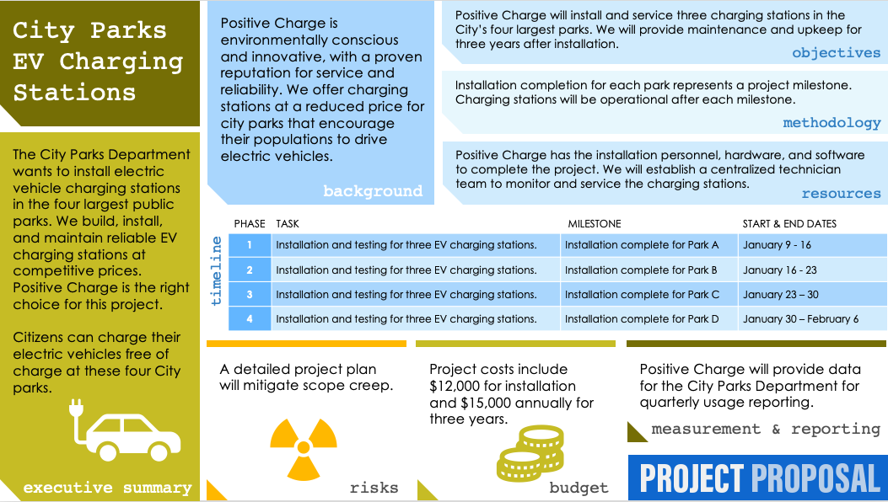
ONE-PAGE PROJECT PROPOSAL TEMPLATE for PowerPoint
Use this template to clearly and succinctly present standard project proposal information, such as the executive summary, project background, and objectives, but without the hassle of arranging slides. This one-page project proposal template provides a complete picture of your proposal at a glance. Communicate your proposal's budget estimate with a simple chart, then outline your project phases with their corresponding tasks and start and end dates. Use this template to list any potential risks alongside your mitigation strategies. The sample version of this template serves as a useful guide for creating and presenting your own one-page project proposal.

Slide 2


Project Title
Enter Text
Enter Text
objectives
Enter Text
methodology
Enter Text
Enter Text
background
resources
PHASE | TASK | MILESTONE | START & END DATES
1
2
3
4
timeline
Enter Text
Enter Text
Enter Text
measurement & reporting
executive summary
risks
budget

Slide 3
DISCLAIMER Any articles, templates, or information provided by Smartsheet on the website are for reference only. While we strive to keep the information up to date and correct, we make no representations or warranties of any kind, express or implied, about the completeness, accuracy, reliability, suitability, or availability with respect to the website or the information, articles, templates, or related graphics contained on the website. Any reliance you place on such information is therefore strictly at your own risk.

