Slide 1

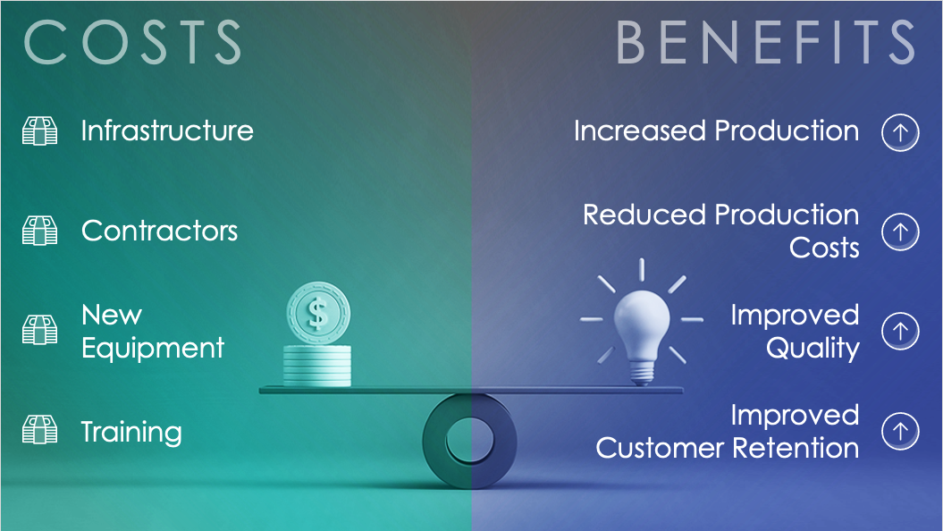

SAMPLE COST-BENEFIT TEMPLATE for PowerPoint
This cost-benefit template, available with or without sample data, provides a straightforward and effective explanation of your project’s expenses and savings. Add the costs and benefits to create a visual impact of the comparisons. Share the completed slide with team members and stakeholders to inform them of the monetary elements of the proposed project. You can also easily add the slide to an existing PowerPoint presentation for an upcoming project.

Slide 2


COSTS
BENEFITS
Infrastructure
Increased Production
Contractors
Reduced Production
Costs
New
Equipment
Improved
Quality
Training
Improved
Customer Retention

Slide 3
COSTS
BENEFITS
Cost One
Benefit One
Cost Two
Benefit Two
Cost Three
Benefit Three
Cost Four
Benefit Four

Slide 4
DISCLAIMER Any articles, templates, or information provided by Smartsheet on the website are for reference only. While we strive to keep the information up to date and correct, we make no representations or warranties of any kind, express or implied, about the completeness, accuracy, reliability, suitability, or availability with respect to the website or the information, articles, templates, or related graphics contained on the website. Any reliance you place on such information is therefore strictly at your own risk.

