Slide 1

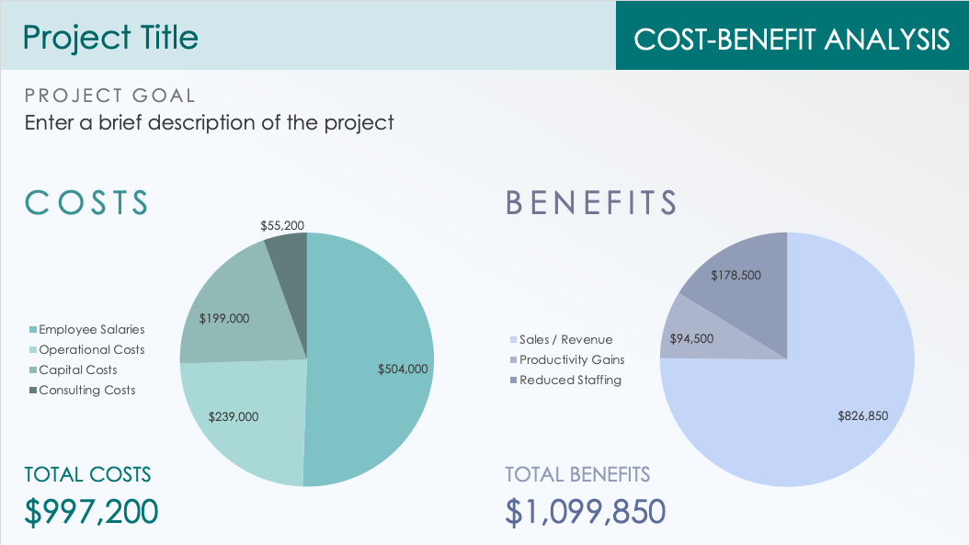
COST-BENEFIT ANALYSIS TEMPLATE
for PowerPoint
Use this cost-benefit analysis template to clearly illustrate if the benefits outweigh the costs of your proposed project. The pie charts offer a high-level overview, while the table allows space to break down the specific details of your costs and benefits. The dashboard layout of this template provides a visual impact that is easy to digest so shareholders can make a well-informed financial decision.

Slide 2
Project Title
COST-BENEFIT ANALYSIS
PROJECT GOAL
Enter a brief description of the project
COSTS
BENEFITS
TOTAL COSTS
TOTAL BENEFITS
$997,200
$1,099,850

Slide 3
DISCLAIMER Any articles, templates, or information provided by Smartsheet on the website are for reference only. While we strive to keep the information up to date and correct, we make no representations or warranties of any kind, express or implied, about the completeness, accuracy, reliability, suitability, or availability with respect to the website or the information, articles, templates, or related graphics contained on the website. Any reliance you place on such information is therefore strictly at your own risk.

