Slide 1

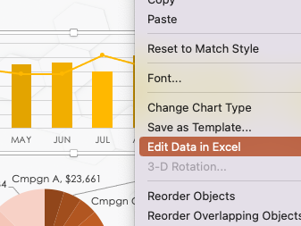
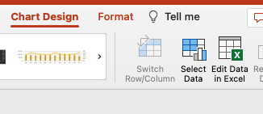
PPC PRESENTATION TEMPLATE
Notes for Using This Template
Input values to populate the chart data by highlighting a chart and right-clicking to select:
Edit Data in Excel …
Or – with chart selected – go to the Chart Design tab and select ”Edit Data in Excel” from the top menu.

Slide 2





AD COST
CLICKS
IMPRESSIONS
CLICK THRU RATE
CONVERSIONS
COST PER CONVERSION
$493,269
388,387
1,103,845
35.18%
3,331
$148.08
AD IMPRESSIONS
COST PER CLICK
COST PER THOUSAND IMP
$1.27
$446.86
AD COST
TOP CAMPAIGNS by Conversion

Slide 3
NOTES
summary information / comments

Slide 4
DISCLAIMER Any articles, templates, or information provided by Smartsheet on the website are for reference only. While we strive to keep the information up to date and correct, we make no representations or warranties of any kind, express or implied, about the completeness, accuracy, reliability, suitability, or availability with respect to the website or the information, articles, templates, or related graphics contained on the website. Any reliance you place on such information is therefore strictly at your own risk.

