Slide 1


PROJECT DASHBOARD TEMPLATE
Use the Project Dashboard Template in Excel to enter data that will populate the charts and graphs for your dashboard. Place screenshots of each element on the following slides to build out your Project Dashboard Presentation.
PROJECT DASHBOARD PRESENTATION

Slide 2
[ PROJECT NAME ]
PROJECT DASHBOARD
DATE | PROJECT STATUS | % COMPLETE
00/00/0000 | In Progress | 72%
PROJECT DASHBOARD PRESENTATION

Slide 3
TABLE OF CONTENTS
1
2
3
4
5
6
7
8
Dashboard Overview
Dashboard Data
Task Timeline
Task Status
Task Priority
Budget
Pending Items
Summary
PROJECT DASHBOARD PRESENTATION | TABLE OF CONTENTS
PROJECT REPORT

Slide 4
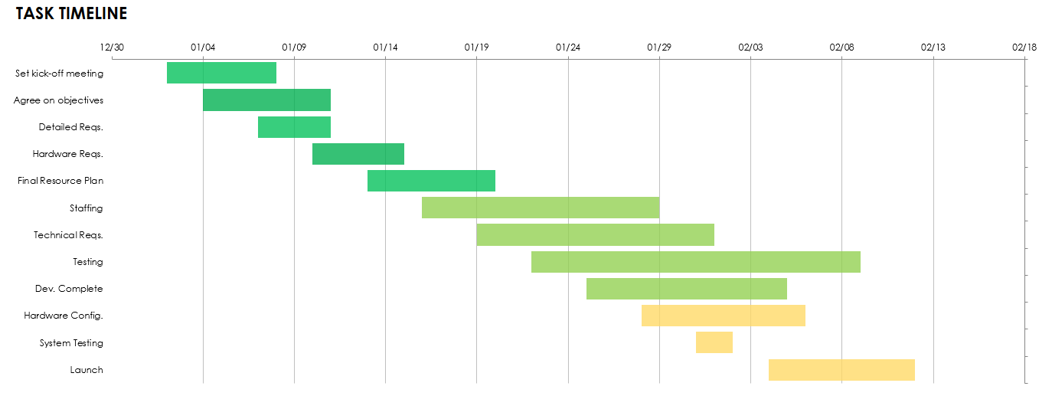
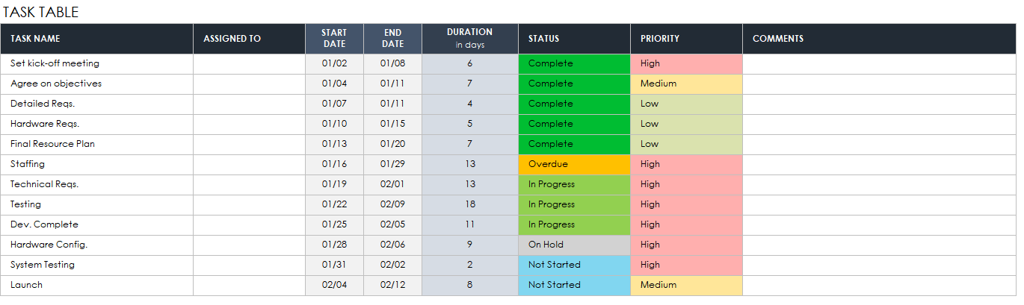
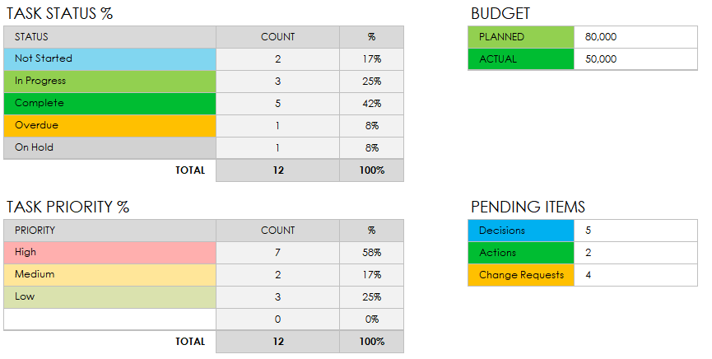
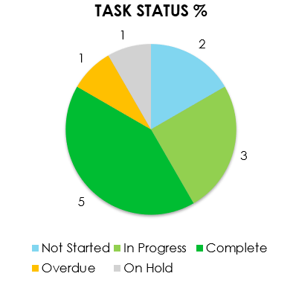
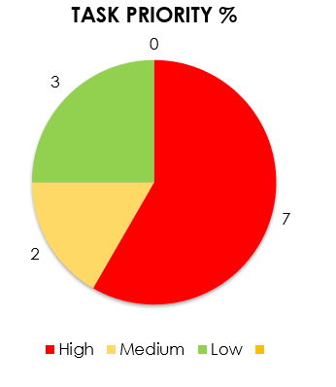
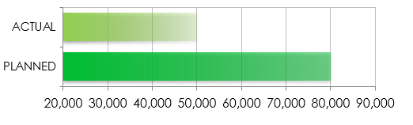
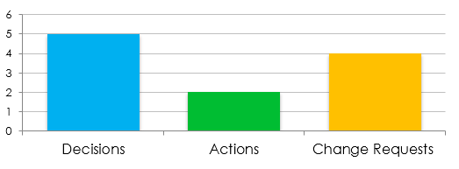
1. DASHBOARD OVERVIEW
TASK TIMELINE
DASHBOARD DATA
TASK PRIORITY %
TASK STATUS
BUDGET
PENDING ITEMS
PROJECT DASHBOARD OVERVIEW
PROJECT REPORT

Slide 5
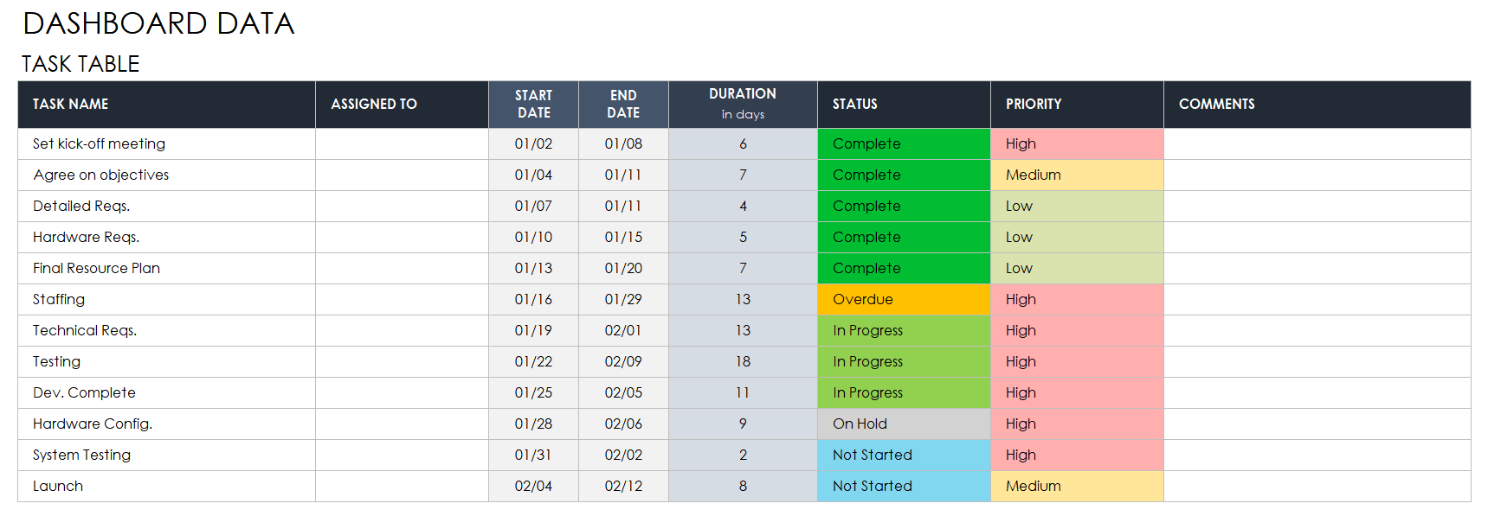
2. DASHBOARD DATA
PROJECT REPORT
DASHBOARD DATA

Slide 6
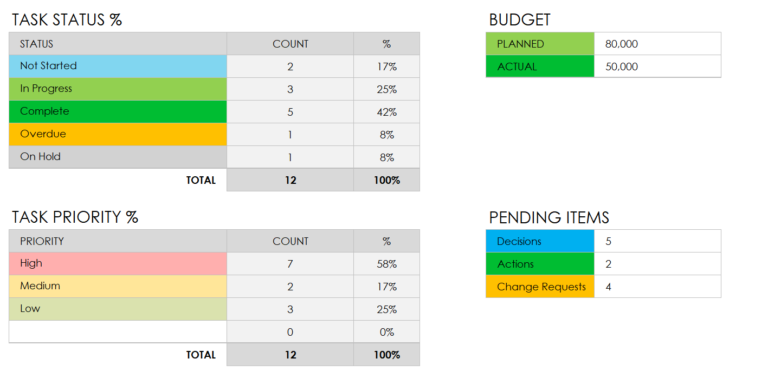
2. DASHBOARD DATA
PROJECT REPORT
DASHBOARD DATA

Slide 7

3. TASK TIMELINE
PROJECT REPORT
DASHBOARD DATA

Slide 8
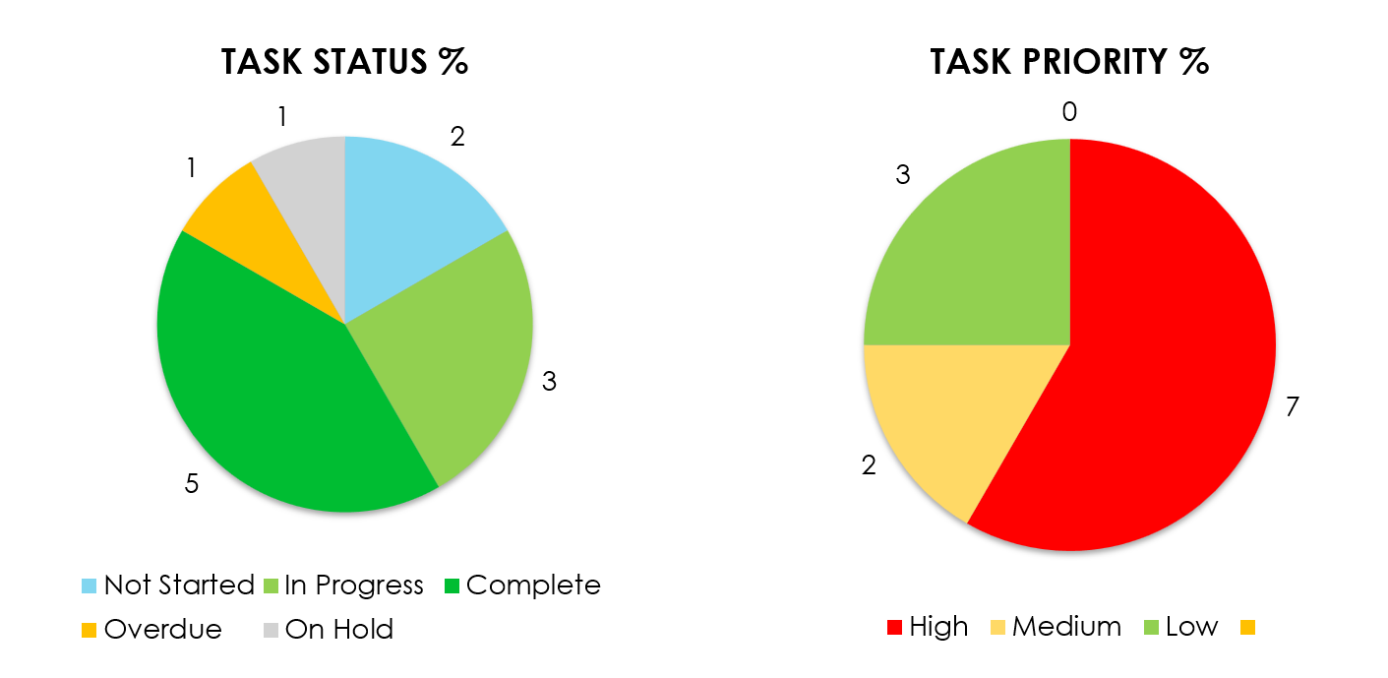
4. TASK STATUS
PROJECT REPORT
TASK STATUS

Slide 9
5. TASK PRIORITY
PROJECT REPORT
TASK PRIORITY

Slide 10
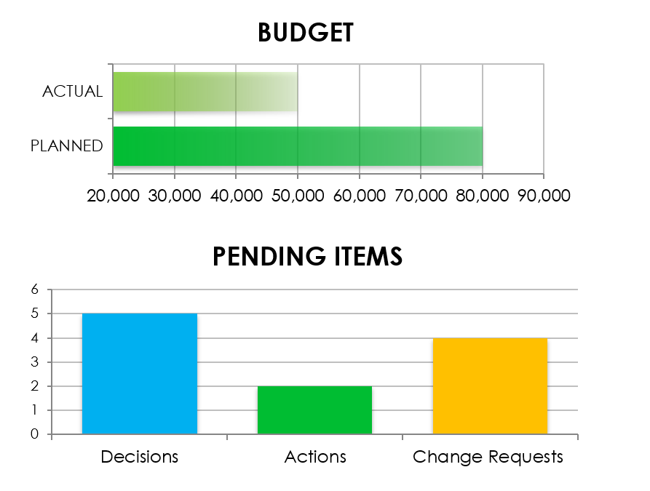
6. BUDGET
PROJECT REPORT
BUDGET

Slide 11
7. PENDING ITEMS
PROJECT REPORT
PENDING ITEMS

Slide 12

8. SUMMARY
Include any other critical information.
PROJECT REPORT
SUMMARY

Slide 13
DISCLAIMER Any articles, templates, or information provided by Smartsheet on the website are for reference only. While we strive to keep the information up to date and correct, we make no representations or warranties of any kind, express or implied, about the completeness, accuracy, reliability, suitability, or availability with respect to the website or the information, articles, templates, or related graphics contained on the website. Any reliance you place on such information is therefore strictly at your own risk.

