Slide 1


PROOF OF CONCEPT PRESENTATION TEMPLATE
A proof of concept (POC) is a process that verifies whether a business idea is feasible. Through research and testing, a POC demonstrates that a product, feature, service, or other solution can become a reality and warrants further development.

Slide 2

Create a proof-of-concept presentation. Use the presentation as part of a POC proposal or to present results to stakeholders. Add your data to the slides, including graphs or other visual illustrations. Focus on adding elements that help demonstrate the product’s need, the viability of your idea, and how it meets customer and business requirements. Adjust the headings and add or remove slides to create a clear and compelling presentation.

Slide 3
Project, Product, Feature,
or Service Name

Slide 4
Business Case
  Problem Statement
  Business Opportunity
POC Goals
POC Approach
Required Resources
Success Criteria
Timeline
Next Steps if POC Is Successful

Slide 5
Business Case
Problem Statement
Describe the problem you're trying to solve or the reason your product needs to exist. Identify customer pain points by interviewing a sample group from your target market.
Business Opportunity
Use customer feedback to brainstorm solutions. Assess your ideas based on constraints, such as time, cost, resources, technology requirements, etc., in order to identify feasible solutions.

Slide 6
POC Goals
What are you trying to achieve with your POC project? Communicate with internal stakeholders to understand and align goals and expectations.
Goal One
Goal Two
Goal Three

Slide 7
POC Approach
Approach details.
Stage One
Stage Two
Stage Three

Slide 8
Required Resources
Resource details.
Resource One
Resource Two
Resource Three

Slide 9
Success Criteria
How will you verify that your goals have been achieved?
What metrics will you use to evaluate your idea?
Criterion One
Criterion Two
Criterion Three

Slide 10
Timeline
Estimate duration based on the scope of the POC, important progress dates, and requirements for project completion.
Stage One
Stage Two
Stage Three

Slide 11
Next Steps if POC Is Successful
Create a proposal for action steps to take if the POC is successful.
Action Step One
Action Step Two
Action Step Three

Slide 12
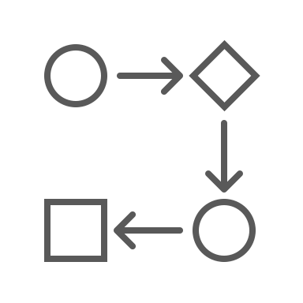
Notes
Additional comments.

Slide 13
DISCLAIMER Any articles, templates, or information provided by Smartsheet on the website are for reference only. While we strive to keep the information up to date and correct, we make no representations or warranties of any kind, express or implied, about the completeness, accuracy, reliability, suitability, or availability with respect to the website or the information, articles, templates, or related graphics contained on the website. Any reliance you place on such information is therefore strictly at your own risk.

