Slide 1
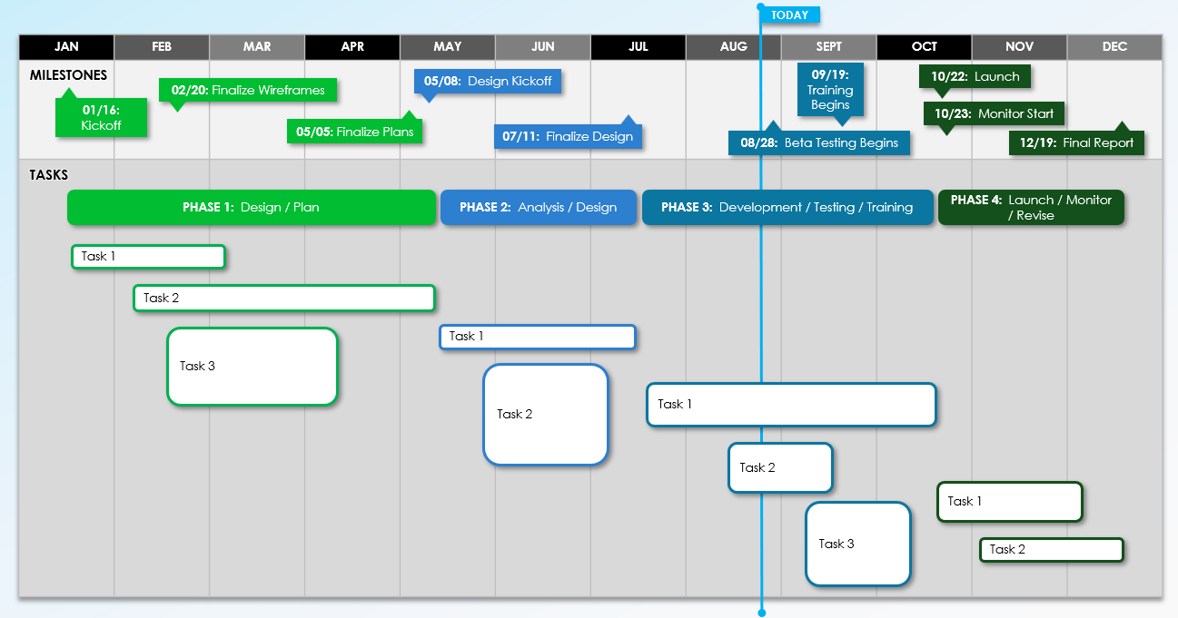
Project Roadmap Timeline Template

Slide 2
Project Name
Project Deliverable
Enter Text
Scope Statement
Enter Text
PROJECT MANAGER |  | START DATE
OVERALL PROGRESS |  | END DATE

Slide 3
TODAY
JAN | FEB | MAR | APR | MAY | JUN | JUL | AUG | SEPT | OCT | NOV | DEC
MILESTONES
05/08: Design Kickoff
09/19: Training Begins
10/22: Launch
02/20: Finalize Wireframes
01/16:
Kickoff
10/23: Monitor Start
05/05: Finalize Plans
07/11: Finalize Design
08/28: Beta Testing Begins
12/19: Final Report
TASKS
PHASE 1: Design / Plan
PHASE 2: Analysis / Design
PHASE 3: Development / Testing / Training
PHASE 4: Launch / Monitor / Revise
Task 1
Task 2
Task 3
Task 1
Task 2
Task 1
Task 2
Task 1
Task 3
Task 2
Project Roadmap Timeline Template

Slide 4
Enter Text
Comments
Provided by Smartsheet, Inc.

Slide 5
DISCLAIMER Any articles, templates, or information provided by Smartsheet on the website are for reference only. While we strive to keep the information up to date and correct, we make no representations or warranties of any kind, express or implied, about the completeness, accuracy, reliability, suitability, or availability with respect to the website or the information, articles, templates, or related graphics contained on the website. Any reliance you place on such information is therefore strictly at your own risk.

