Slide 1
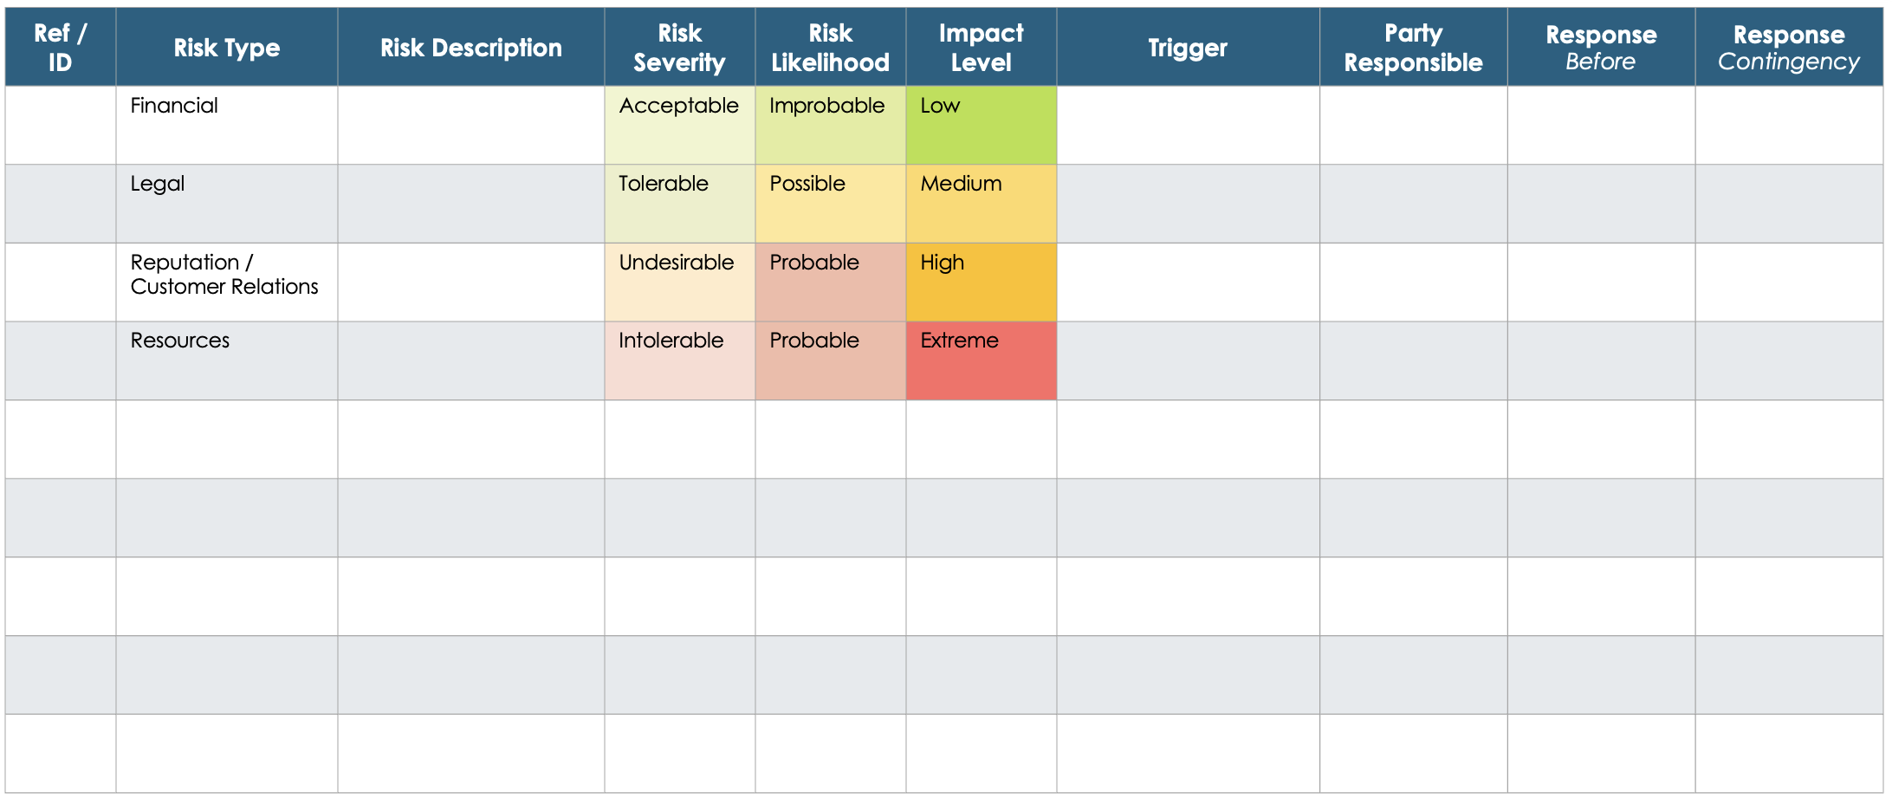
Project Risk Matrix Template

Slide 2
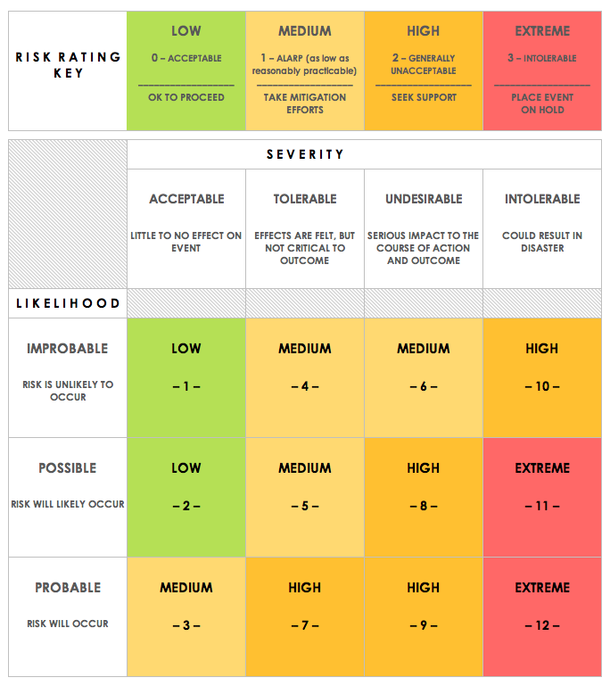
Project Risk Matrix
Ref / ID | Risk Type | Risk Description | Risk Severity | Risk Likelihood | Impact Level | Trigger | Party Responsible | Response Before | Response Contingency
 | Financial |  | Acceptable | Improbable | Low
 | Legal |  | Tolerable | Possible | Medium
 | Reputation / Customer Relations |  | Undesirable | Probable | High
 | Resources |  | Intolerable | Probable | Extreme

Slide 3
Risk Rating Matrix
Provided by Smartsheet, Inc.

Slide 4
DISCLAIMER Any articles, templates, or information provided by Smartsheet on the website are for reference only. While we strive to keep the information up to date and correct, we make no representations or warranties of any kind, express or implied, about the completeness, accuracy, reliability, suitability, or availability with respect to the website or the information, articles, templates, or related graphics contained on the website. Any reliance you place on such information is therefore strictly at your own risk.

