Slide 1

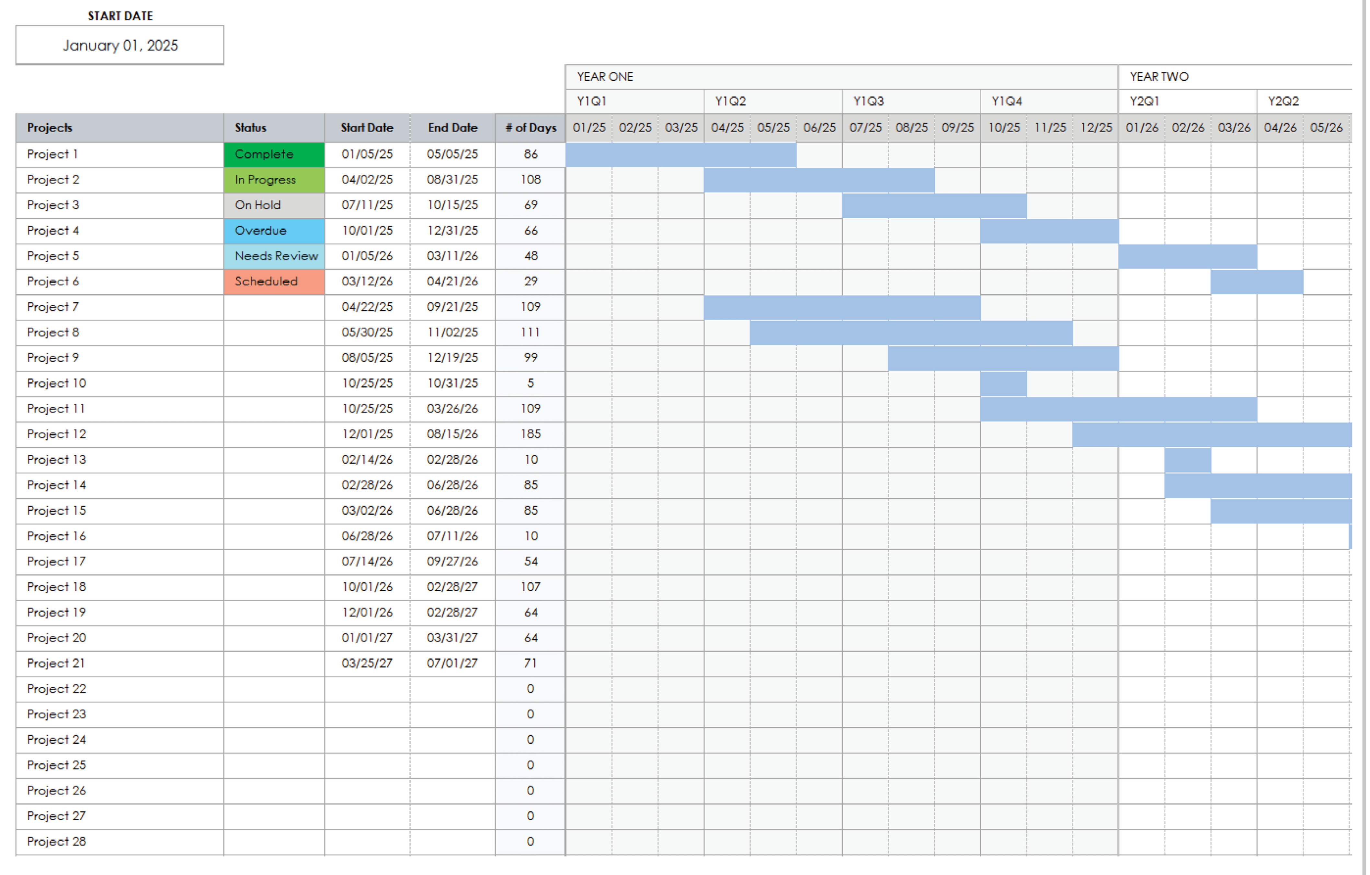
Project Portfolio Roadmap Template

Slide 2
Year One Project Progress
Q1 – 20XX | Q2 – 20XX | Q3 – 20XX | Q4 – 20XX
Project 1
Project 2
Project 3
Project 4
Project 5

Slide 3
Year Two Project Progress
Q1 – 20XX | Q2 – 20XX | Q3 – 20XX | Q4 – 20XX
Project 1
Project 2
Project 3
Project 4
Project 5

Slide 4
Year Three Project Progress
Q1 – 20XX | Q2 – 20XX | Q3 – 20XX | Q4 – 20XX
Project 1
Project 2
Project 3
Project 4
Project 5

Slide 5
Portfolio Overview
Projects | Status | Start Date | End Date | # of Days
Project 1 | Complete | 01/05/25 | 05/05/25 | 86
Project 2 | In Progress | 04/02/25 | 08/31/25 | 108
Project 3 | On Hold | 07/11/25 | 10/15/25 | 69
Project 4 | Overdue | 10/01/25 | 12/31/25 | 66
Project 5 | Needs Review | 01/05/26 | 03/11/26 | 48
Project 6 | Proposed | 03/12/26 | 04/21/26 | 29
Project 7 | Scheduled | 04/22/25 | 09/21/25 | 109
Project 8 |  | 05/30/25 | 11/02/25 | 111
Project 9 |  | 08/05/25 | 12/19/25 | 99
Project 10 |  | 10/25/25 | 10/31/25 | 5
Provided by Smartsheet, Inc.

Slide 6
DISCLAIMER Any articles, templates, or information provided by Smartsheet on the website are for reference only. While we strive to keep the information up to date and correct, we make no representations or warranties of any kind, express or implied, about the completeness, accuracy, reliability, suitability, or availability with respect to the website or the information, articles, templates, or related graphics contained on the website. Any reliance you place on such information is therefore strictly at your own risk.

