Slide 1

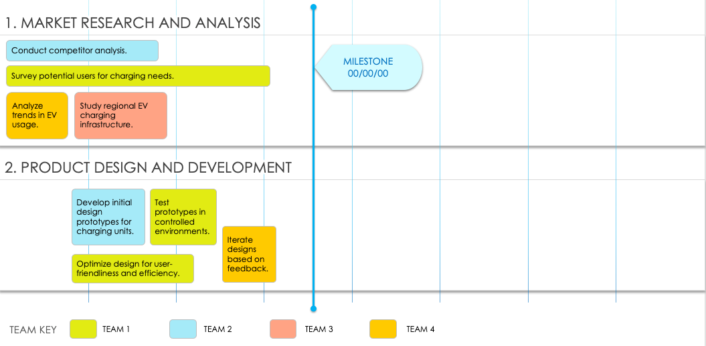
One-Page Project Roadmap Template
This easy-to-use roadmap template is ideal for keeping tabs on the status and progress of project-related components.
TO USE THIS TEMPLATE:
Enter Dates.
Apply Teams, Phases or Team Members to the Key.
Enter Tasks and Milestones.

Slide 2
Team or Phase
Team or Phase 1
Team or Phase 2
Team or Phase 3
Team or Phase 4
Month 1
Month 2
Month 3
Month 4
Month 5
Month 6
1. TEXT
00/00
00/00
00/00
00/00
00/00
00/00
MILESTONE
00/00/00
2. TEXT
3. TEXT
Provided by Smartsheet, Inc.

Slide 3
DISCLAIMER Any articles, templates, or information provided by Smartsheet on the website are for reference only. While we strive to keep the information up to date and correct, we make no representations or warranties of any kind, express or implied, about the completeness, accuracy, reliability, suitability, or availability with respect to the website or the information, articles, templates, or related graphics contained on the website. Any reliance you place on such information is therefore strictly at your own risk.

