Slide 1
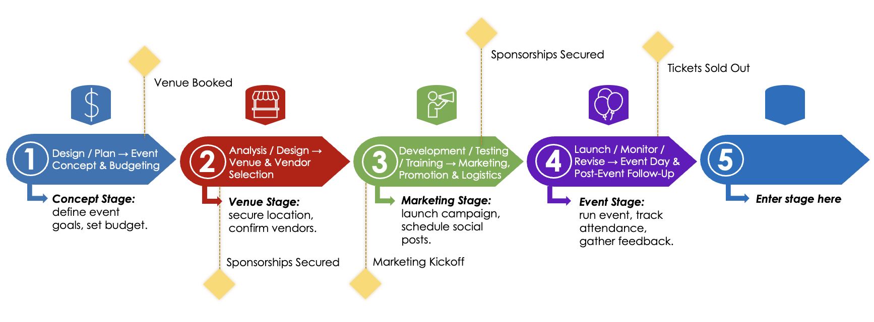
Event PowerPoint Timeline Template

Slide 2




Event PowerPoint Timeline Template
Sponsorships Secured
Tickets Sold Out
Venue Booked
1
Design / Plan → Event Concept & Budgeting
2
Analysis / Design → Venue & Vendor Selection
3
Development / Testing / Training → Marketing, Promotion & Logistics
4
Launch / Monitor / Revise → Event Day & Post-Event Follow-Up
5
Concept Stage: define event goals, set budget.
Venue Stage: secure location, confirm vendors.
Marketing Stage: launch campaign, schedule social posts.
Event Stage: run event, track attendance, gather feedback.
Enter stage here
Sponsorships Secured
Marketing Kickoff
Event Report: Use this for outcomes like attendance, revenue, or satisfaction scores like attendance, revenue, or satisfaction scores.
Event Timeline PowerPoint Template
Provided by Smartsheet, Inc.

Slide 3
DISCLAIMER Any articles, templates, or information provided by Smartsheet on the website are for reference only. While we strive to keep the information up to date and correct, we make no representations or warranties of any kind, express or implied, about the completeness, accuracy, reliability, suitability, or availability with respect to the website or the information, articles, templates, or related graphics contained on the website. Any reliance you place on such information is therefore strictly at your own risk.

