Slide 1

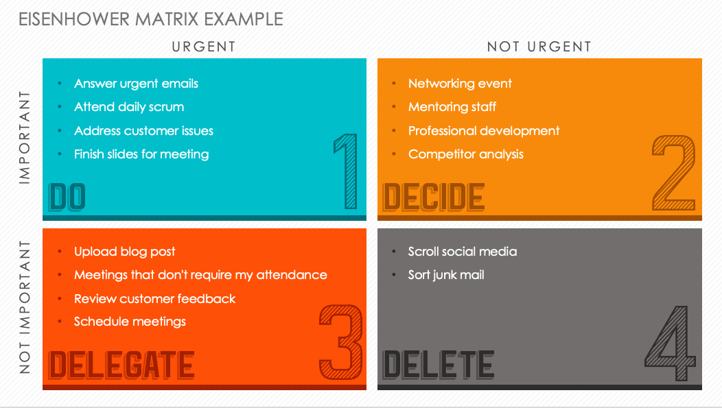
EISENHOWER MATRIX TEMPLATE
Notes for Using This Template
Use this template to prioritize project tasks and determine which activities to tackle, delegate, or delete in order to make the most efficient use of your time.
Blank template on slide 3.

Slide 2
EISENHOWER MATRIX EXAMPLE
URGENT
NOT URGENT
Answer urgent emails
Attend daily scrum
Address customer issues
Finish slides for meeting
Networking event
Mentoring staff
Professional development
Competitor analysis
IMPORTANT
Upload blog post
Meetings that don't require my attendance
Review customer feedback
Schedule meetings
Scroll social media
Sort junk mail
NOT IMPORTANT

Slide 3
EISENHOWER MATRIX
URGENT
NOT URGENT
Enter Text
Enter Text
IMPORTANT
Enter Text
Enter Text
NOT IMPORTANT

Slide 4
DISCLAIMER Any articles, templates, or information provided by Smartsheet on the website are for reference only. While we strive to keep the information up to date and correct, we make no representations or warranties of any kind, express or implied, about the completeness, accuracy, reliability, suitability, or availability with respect to the website or the information, articles, templates, or related graphics contained on the website. Any reliance you place on such information is therefore strictly at your own risk.

