Slide 1
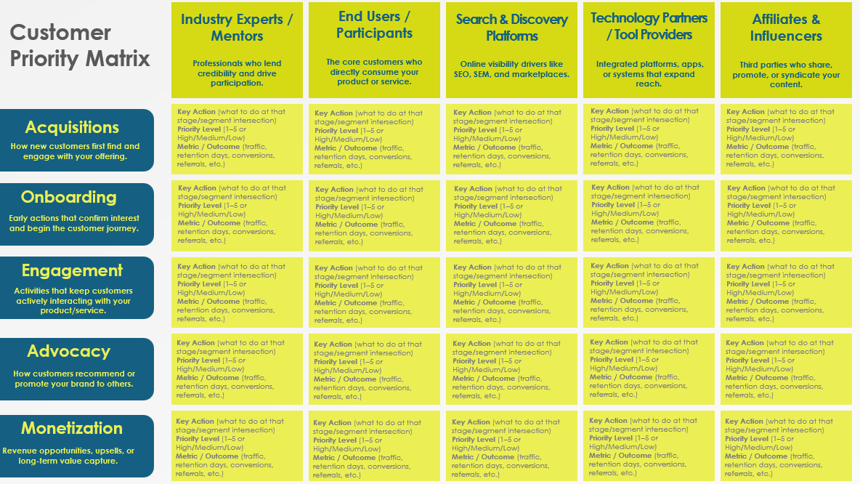
Customer Priority Matrix Template

Slide 2
Industry Experts / Mentors
End Users / Participants
Search & Discovery Platforms
Technology Partners / Tool Providers
Affiliates & Influencers
Customer Priority Matrix
Professionals who lend credibility and drive participation.
The core customers who directly consume your product or service.
Online visibility drivers like SEO, SEM, and marketplaces.
Integrated platforms, apps, or systems that expand reach.
Third parties who share, promote, or syndicate your content.
Key Action (what to do at that stage/segment intersection)
Priority Level (1–5 or High/Medium/Low)
Metric / Outcome (traffic, retention days, conversions, referrals, etc.)
Key Action (what to do at that stage/segment intersection)
Priority Level (1–5 or High/Medium/Low)
Metric / Outcome (traffic, retention days, conversions, referrals, etc.)
Key Action (what to do at that stage/segment intersection)
Priority Level (1–5 or High/Medium/Low)
Metric / Outcome (traffic, retention days, conversions, referrals, etc.)
Key Action (what to do at that stage/segment intersection)
Priority Level (1–5 or High/Medium/Low)
Metric / Outcome (traffic, retention days, conversions, referrals, etc.)
Key Action (what to do at that stage/segment intersection)
Priority Level (1–5 or High/Medium/Low)
Metric / Outcome (traffic, retention days, conversions, referrals, etc.)
Acquisitions
How new customers first find and engage with your offering.
Onboarding
Key Action (what to do at that stage/segment intersection)
Priority Level (1–5 or High/Medium/Low)
Metric / Outcome (traffic, retention days, conversions, referrals, etc.)
Key Action (what to do at that stage/segment intersection)
Priority Level (1–5 or High/Medium/Low)
Metric / Outcome (traffic, retention days, conversions, referrals, etc.)
Key Action (what to do at that stage/segment intersection)
Priority Level (1–5 or High/Medium/Low)
Metric / Outcome (traffic, retention days, conversions, referrals, etc.)
Key Action (what to do at that stage/segment intersection)
Priority Level (1–5 or High/Medium/Low)
Metric / Outcome (traffic, retention days, conversions, referrals, etc.)
Key Action (what to do at that stage/segment intersection)
Priority Level (1–5 or High/Medium/Low)
Metric / Outcome (traffic, retention days, conversions, referrals, etc.)
Early actions that confirm interest and begin the customer journey.
Engagement
Key Action (what to do at that stage/segment intersection)
Priority Level (1–5 or High/Medium/Low)
Metric / Outcome (traffic, retention days, conversions, referrals, etc.)
Key Action (what to do at that stage/segment intersection)
Priority Level (1–5 or High/Medium/Low)
Metric / Outcome (traffic, retention days, conversions, referrals, etc.)
Key Action (what to do at that stage/segment intersection)
Priority Level (1–5 or High/Medium/Low)
Metric / Outcome (traffic, retention days, conversions, referrals, etc.)
Key Action (what to do at that stage/segment intersection)
Priority Level (1–5 or High/Medium/Low)
Metric / Outcome (traffic, retention days, conversions, referrals, etc.)
Key Action (what to do at that stage/segment intersection)
Priority Level (1–5 or High/Medium/Low)
Metric / Outcome (traffic, retention days, conversions, referrals, etc.)
Activities that keep customers actively interacting with your product/service.
Advocacy
Key Action (what to do at that stage/segment intersection)
Priority Level (1–5 or High/Medium/Low)
Metric / Outcome (traffic, retention days, conversions, referrals, etc.)
Key Action (what to do at that stage/segment intersection)
Priority Level (1–5 or High/Medium/Low)
Metric / Outcome (traffic, retention days, conversions, referrals, etc.)
Key Action (what to do at that stage/segment intersection)
Priority Level (1–5 or High/Medium/Low)
Metric / Outcome (traffic, retention days, conversions, referrals, etc.)
Key Action (what to do at that stage/segment intersection)
Priority Level (1–5 or High/Medium/Low)
Metric / Outcome (traffic, retention days, conversions, referrals, etc.)
Key Action (what to do at that stage/segment intersection)
Priority Level (1–5 or High/Medium/Low)
Metric / Outcome (traffic, retention days, conversions, referrals, etc.)
How customers recommend or promote your brand to others.
Monetization
Key Action (what to do at that stage/segment intersection)
Priority Level (1–5 or High/Medium/Low)
Metric / Outcome
Key Action (what to do at that stage/segment intersection)
Priority Level (1–5 or High/Medium/Low)
Metric / Outcome
Key Action (what to do at that stage/segment intersection)
Priority Level (1–5 or High/Medium/Low)
Metric / Outcome
Key Action (what to do at that stage/segment intersection)
Priority Level (1–5 or High/Medium/Low)
Metric / Outcome
Key Action (what to do at that stage/segment intersection)
Priority Level (1–5 or High/Medium/Low)
Metric / Outcome
Revenue opportunities, upsells, or long-term value capture.
Provided by Smartsheet, Inc.

Slide 3
DISCLAIMER Any articles, templates, or information provided by Smartsheet on the website are for reference only. While we strive to keep the information up to date and correct, we make no representations or warranties of any kind, express or implied, about the completeness, accuracy, reliability, suitability, or availability with respect to the website or the information, articles, templates, or related graphics contained on the website. Any reliance you place on such information is therefore strictly at your own risk.

