Slide 1

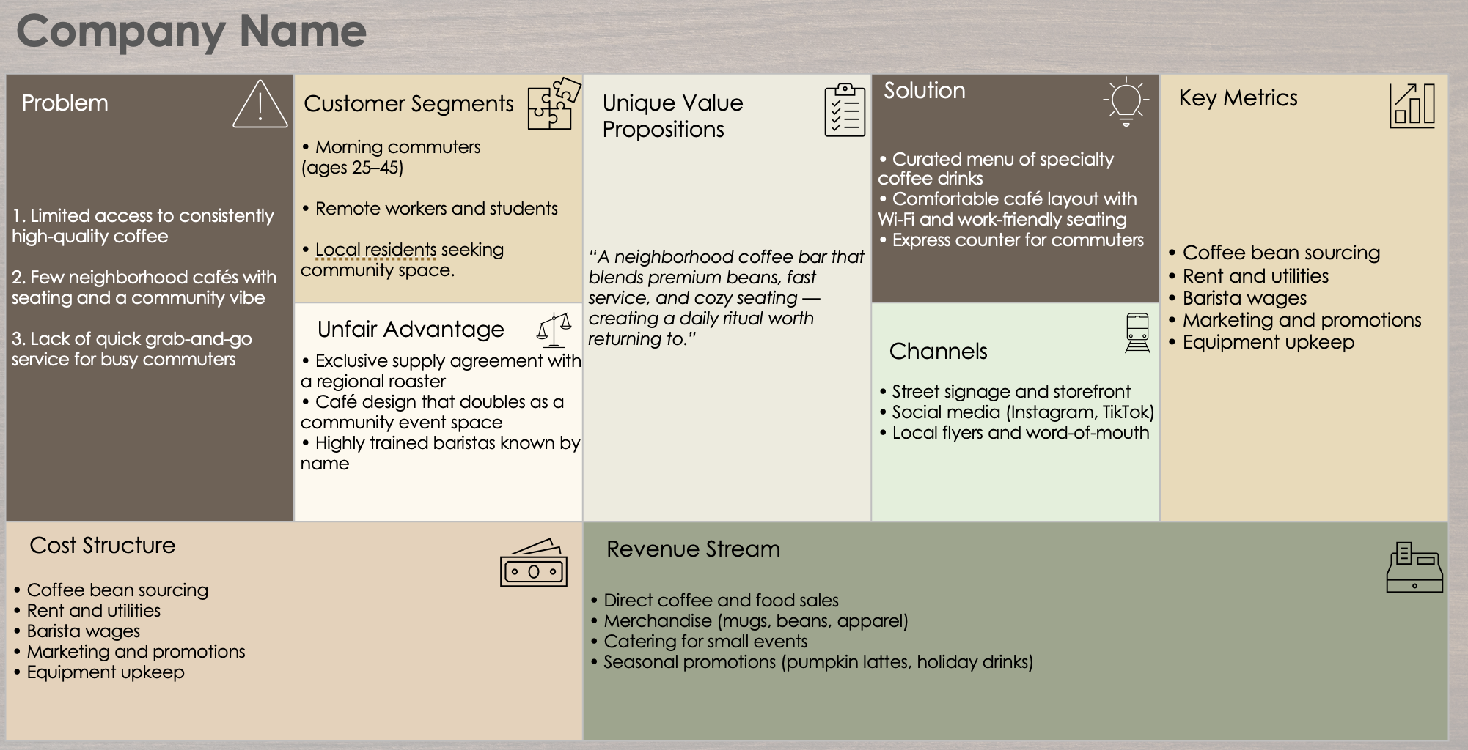
Business Model Canvas / Lean Canvas Template Example

Slide 2





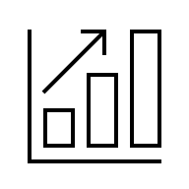
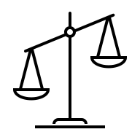



Business Model Canvas / Lean Canvas Template Example
Coffee Shop Business Model
Solution
1. Limited access to consistently high-quality coffee 2. Few neighborhood cafés with seating and a community vibe 3. Lack of quick grab-and-go service for busy commuters | • Morning commuters (ages 25–45) • Remote workers and students • Local residents seeking community space. | “A neighborhood coffee bar that blends premium beans, fast service, and cozy seating — creating a daily ritual worth returning to.” | • Curated menu of specialty coffee drinks • Comfortable café layout with Wi-Fi and work-friendly seating • Express counter for commuters | • Coffee bean sourcing • Rent and utilities • Barista wages • Marketing and promotions • Equipment upkeep
 | • Exclusive supply agreement with a regional roaster • Café design that doubles as a community event space • Highly trained baristas known by name |  | • Street signage and storefront • Social media (Instagram, TikTok) • Local flyers and word-of-mouth
• Coffee bean sourcing • Rent and utilities • Barista wages • Marketing and promotions • Equipment upkeep |  | • Direct coffee and food sales • Merchandise (mugs, beans, apparel) • Catering for small events • Seasonal promotions (pumpkin lattes, holiday drinks)
Problem
Customer Segments
Unique Value Propositions
Key Metrics
Unfair Advantage
Channels
Cost Structure
Revenue Stream

Slide 3
Business Model Canvas / Lean Canvas Template
Company Name
Solution
1. 2. 3. | • • • |  | • • • | • • • • •
 | • • • |  | • • •
• • • • • |  | • • • •
Problem
Customer Segments
Unique Value Propositions
Key Metrics
Unfair Advantage
Channels
Cost Structure
Revenue Stream
Provided by Smartsheet, Inc.

Slide 4
DISCLAIMER Any articles, templates, or information provided by Smartsheet on the website are for reference only. While we strive to keep the information up to date and correct, we make no representations or warranties of any kind, express or implied, about the completeness, accuracy, reliability, suitability, or availability with respect to the website or the information, articles, templates, or related graphics contained on the website. Any reliance you place on such information is therefore strictly at your own risk.

