Slide 1
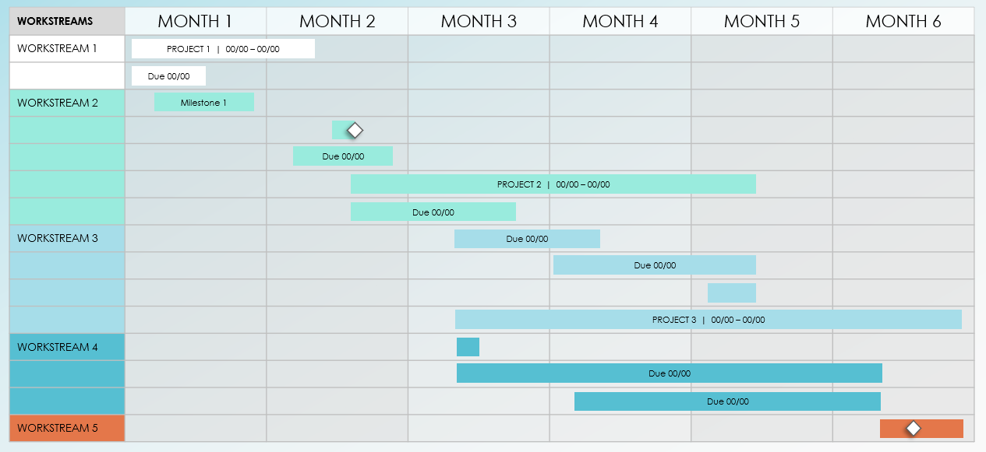
6-Month Project Roadmap Template
Notes for Using This Template
Enter the months and workstreams represented in your plan.
Adjust bars to represent the length of time per activity.
Add Start and End Dates, Milestone Dates, and additional information within each bar or in the chart area.

Slide 2
WORKSTREAMS | MONTH 1 | MONTH 2 | MONTH 3 | MONTH 4 | MONTH 5 | MONTH 6
WORKSTREAM 1
WORKSTREAM 2
WORKSTREAM 3
WORKSTREAM 4
WORKSTREAM 5
PROJECT 1 | 00/00 – 00/00
Due 00/00
Milestone 1
Due 00/00
PROJECT 2 | 00/00 – 00/00
Due 00/00
Due 00/00
Due 00/00
PROJECT 3 | 00/00 – 00/00
Due 00/00
Due 00/00

Slide 3
WORKSTREAMS | MONTH 1 | MONTH 2 | MONTH 3 | MONTH 4 | MONTH 5 | MONTH 6
WORKSTREAM 1
PROJECT 1 | 00/00 – 00/00
Due 00/00
Milestone 1
Due 00/00
PROJECT 2 | 00/00 – 00/00
Due 00/00
Due 00/00
Due 00/00
PROJECT 3 | 00/00 – 00/00
Due 00/00
Due 00/00
Provided by Smartsheet, Inc.

Slide 4
DISCLAIMER Any articles, templates, or information provided by Smartsheet on the website are for reference only. While we strive to keep the information up to date and correct, we make no representations or warranties of any kind, express or implied, about the completeness, accuracy, reliability, suitability, or availability with respect to the website or the information, articles, templates, or related graphics contained on the website. Any reliance you place on such information is therefore strictly at your own risk.

