Slide 1
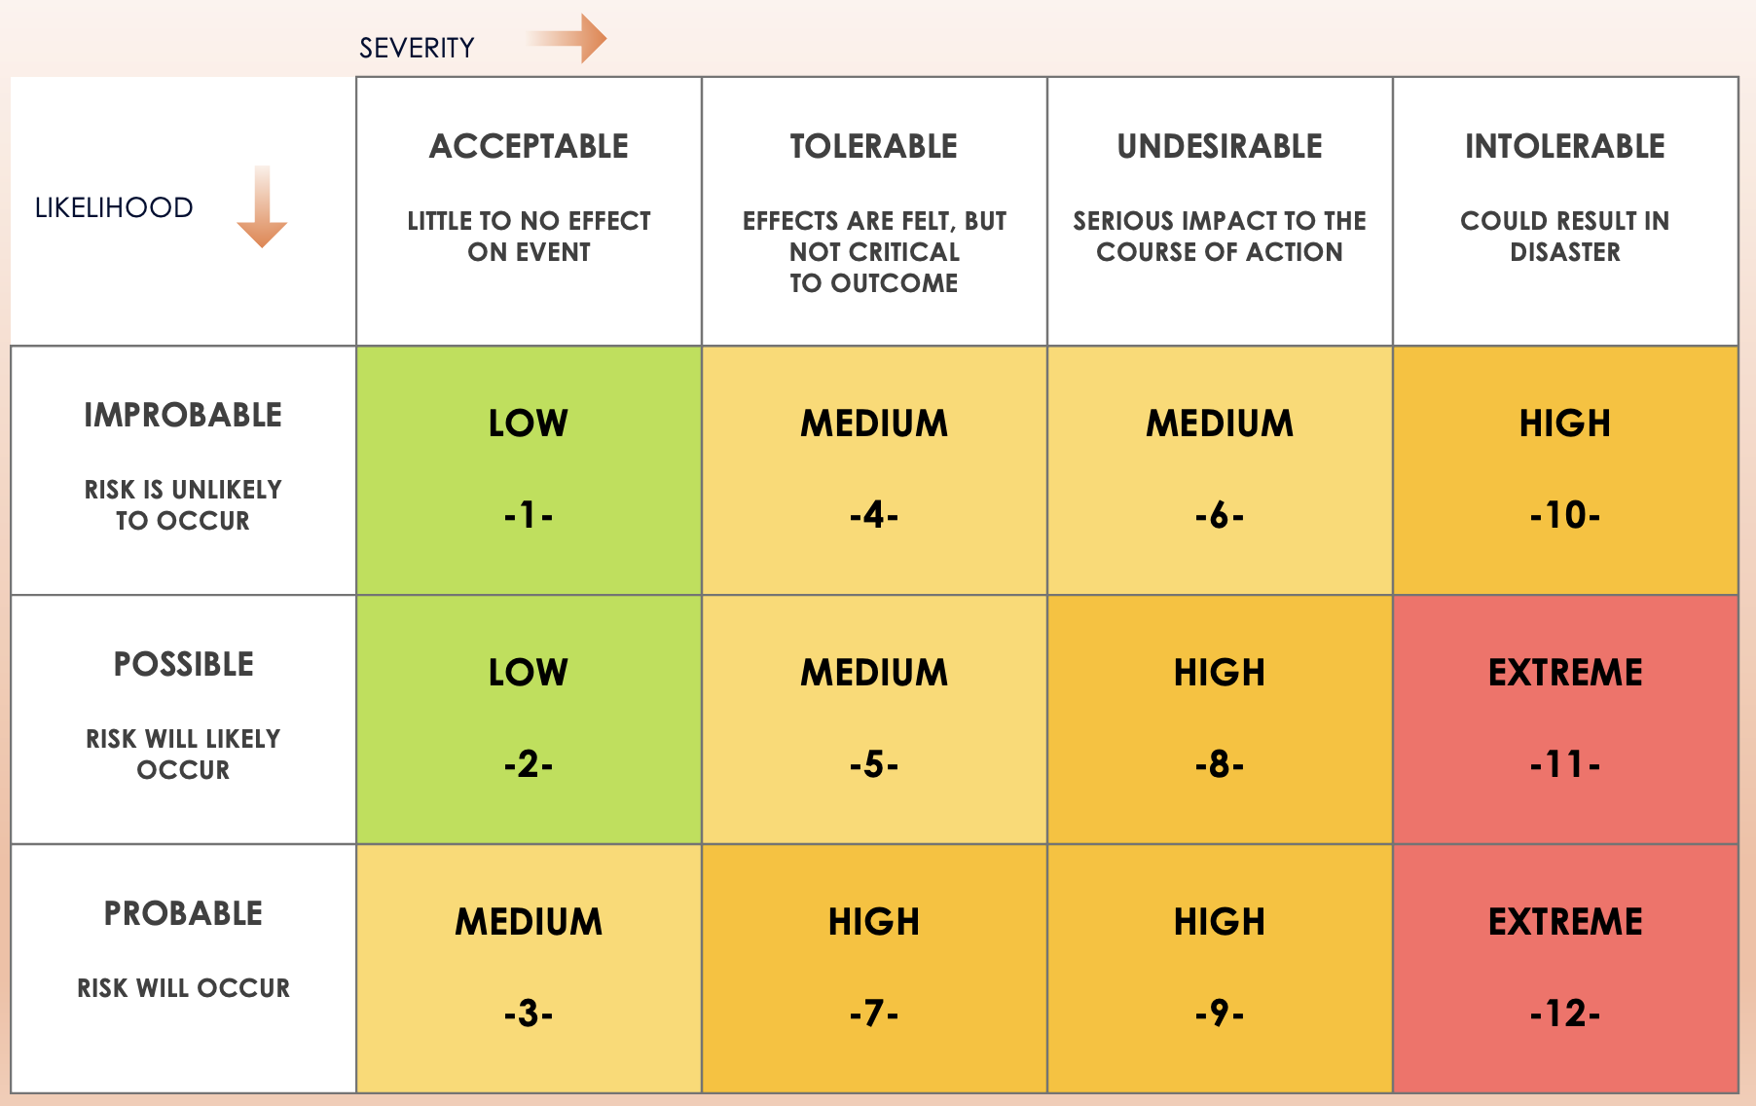
3x4 Risk Matrix Template

Slide 2
3X4 MATRIX
SEVERITY
RISK RATING KEY
 | ACCEPTABLE LITTLE TO NO EFFECT ON EVENT | TOLERABLE EFFECTS ARE FELT, BUT NOT CRITICAL TO OUTCOME | UNDESIRABLE SERIOUS IMPACT TO THE COURSE OF ACTION | INTOLERABLE COULD RESULT IN DISASTER
IMPROBABLE RISK IS UNLIKELY TO OCCUR | LOW -1- | MEDIUM -4- | MEDIUM -6- | HIGH -10-
POSSIBLE RISK WILL LIKELY OCCUR | LOW -2- | MEDIUM -5- | HIGH -8- | EXTREME -11-
PROBABLE RISK WILL OCCUR | MEDIUM -3- | HIGH -7- | HIGH -9- | EXTREME -12-
LOW 0-ACCEPTABLE ------------------------- OK TO PROCEED
MEDIUM 1 – ALARP AS LOW AS REASONABLY PRACTICABLE -------------------- TAKE MITIGATION EFFORTS
HIGH 2 – GENERALLY UNACCEPTABLE --------------------------- SEEK SUPPORT
EXTREME 3 – INTOLERANCE --------------------------- PLACE EVENT ON HOLD
LIKELIHOOD
Provided by Smartsheet, Inc.

Slide 3
DISCLAIMER Any articles, templates, or information provided by Smartsheet on the website are for reference only. While we strive to keep the information up to date and correct, we make no representations or warranties of any kind, express or implied, about the completeness, accuracy, reliability, suitability, or availability with respect to the website or the information, articles, templates, or related graphics contained on the website. Any reliance you place on such information is therefore strictly at your own risk.

